Slide 1

2023
NIAa
Volleyball
Coaches PRE-Season
Rules Clinic
Ellen Townsend, NNVOA
Ellen Townsend, NIAA State Rules Interpreter
etownsend15.et@gmail.com
775-742-9964

Slide 2
Agenda
Welcome Coaches
NIAA Coaches Rules Clinic Information Packet (NIAA.com)
NFHS New rules/Rationale
  Guidelines for accommodations (ex: Migraine earring)
Points of Emphasis (POEs)
Reminders
Sportsmanship and NAC Regulations (NIAA packet on-line)
Stuff
Questions and Comments
Notes:
Go to NIAA.com site. Click on links (Coaches>Sport by Sport> Volleyball.

Slide 3
2023-24 NFHS Volleyball
Rules Changes

Slide 4
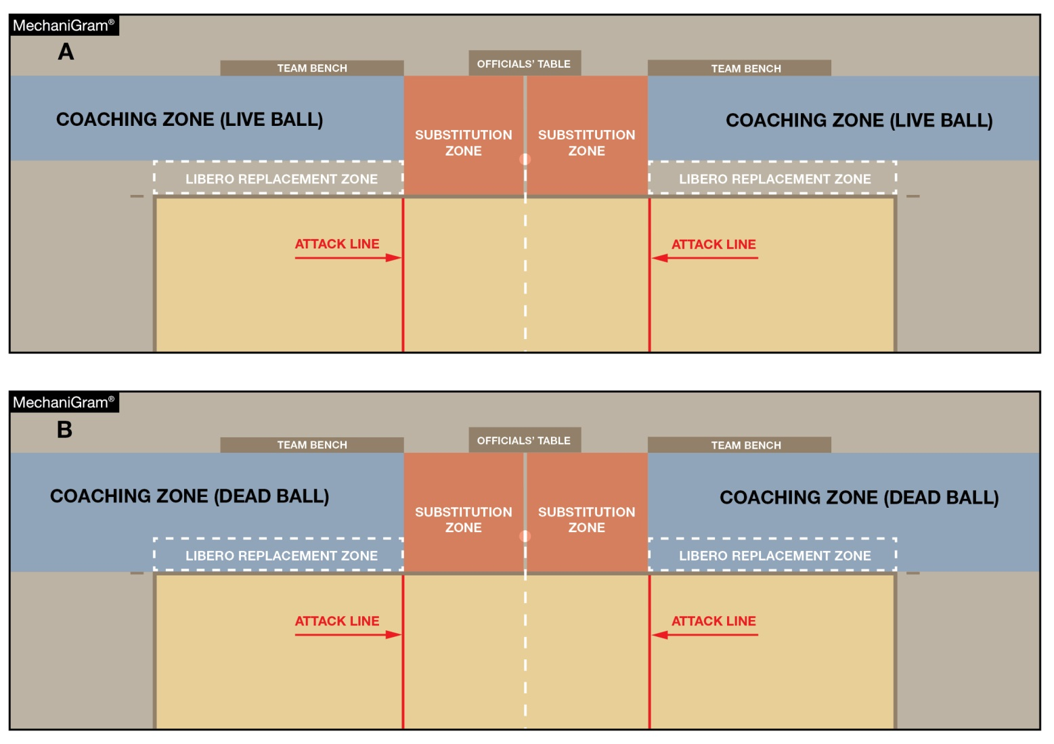
THE COURT AND MARKINGS
2-1-9 (NEW) & 12-2-5
A new Coaching Zone has been established to clearly identify the area in which coaches are allowed to stand.
This area is defined by the libero replacement zone extending beyond the end line and sideline extended.
Head coaches must maintain a distance of at least 6 feet from the sideline during live-ball situations (MechaniGram A) and may approach the sideline during dead-ball situations (MechaniGram B).
Notes:
A new Coaching Zone has been established to clearly identify the area in which coaches are allowed to stand.
This area is defined by the libero replacement zone extending beyond the end line and sideline extended.
Head coaches must maintain a distance of at least 6 feet from the sideline during live-ball situations (MechaniGram A) and may approach the sideline during dead-ball situations (MechaniGram B).
Rationale: Defines and clarifies the area in which coaches may stand.

Slide 5
Notes:
A new Coaching Zone has been established to clearly identify the area in which coaches are allowed to stand.
This area is defined by the libero replacement zone extending beyond the end line and sideline extended.
Head coaches must maintain a distance of at least 6 feet from the sideline during live-ball situations (MechaniGram A) and may approach the sideline during dead-ball situations (MechaniGram B).
Rationale: Defines and clarifies the area in which coaches may stand.

Slide 6
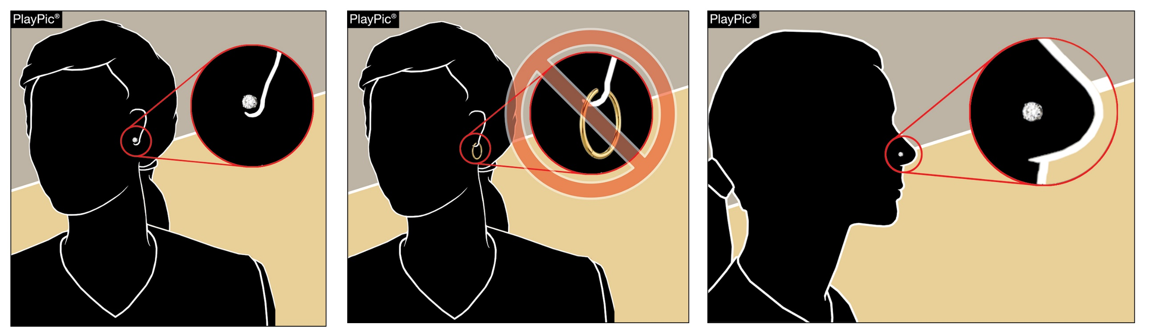
Equipment and accessories
4-1-7
Small, secured stud or post jewelry may be worn above the chin.
No jewelry is permitted below the chin.
No dangles, no hoops, no drops, no huggies, no jackets, no ear climbers, no spacers...
Notes:
Small, secured stud or post jewelry may be worn above the chin.
No jewelry is permitted below the chin.
Rationale: Allows limited use of jewelry above the chin keeping with current trends of other NFHS and volleyball rules codes.

Slide 7
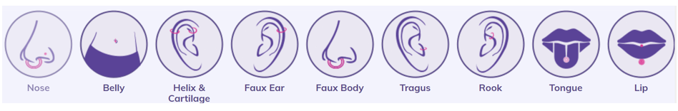
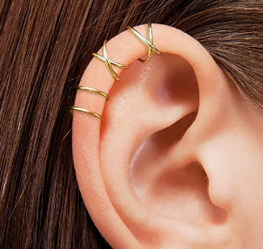
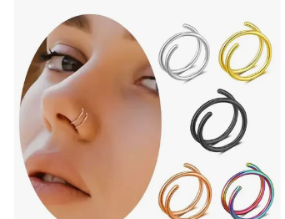
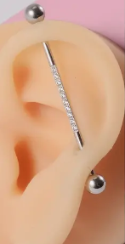
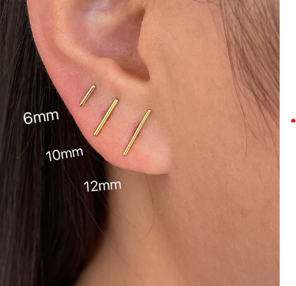
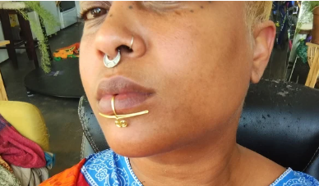
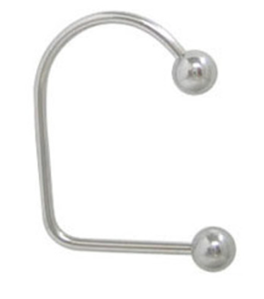
Equipment and accessories
4-1-7
Notes:
Small, secured stud or post jewelry may be worn above the chin.
No jewelry is permitted below the chin.
Rationale: Allows limited use of jewelry above the chin keeping with current trends of other NFHS and volleyball rules codes.

Slide 8
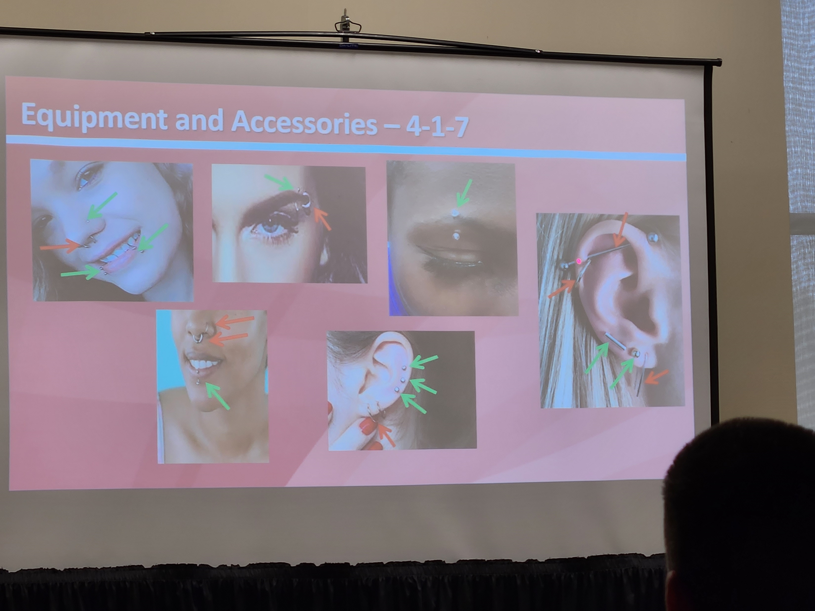

Slide 9
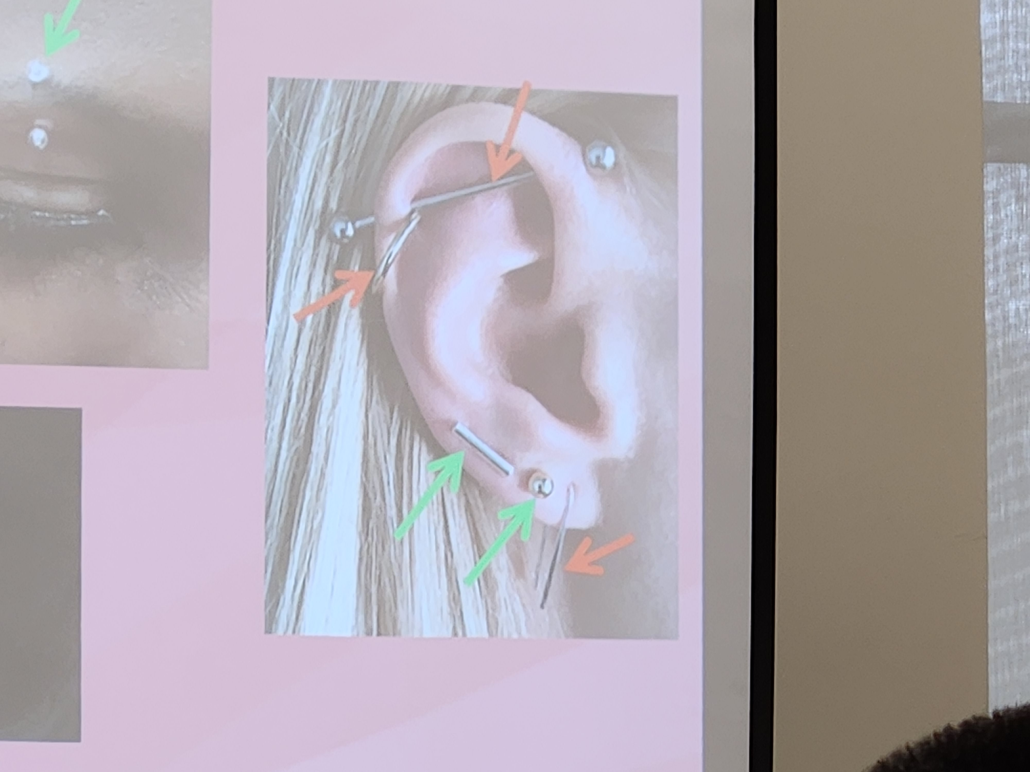

Slide 10
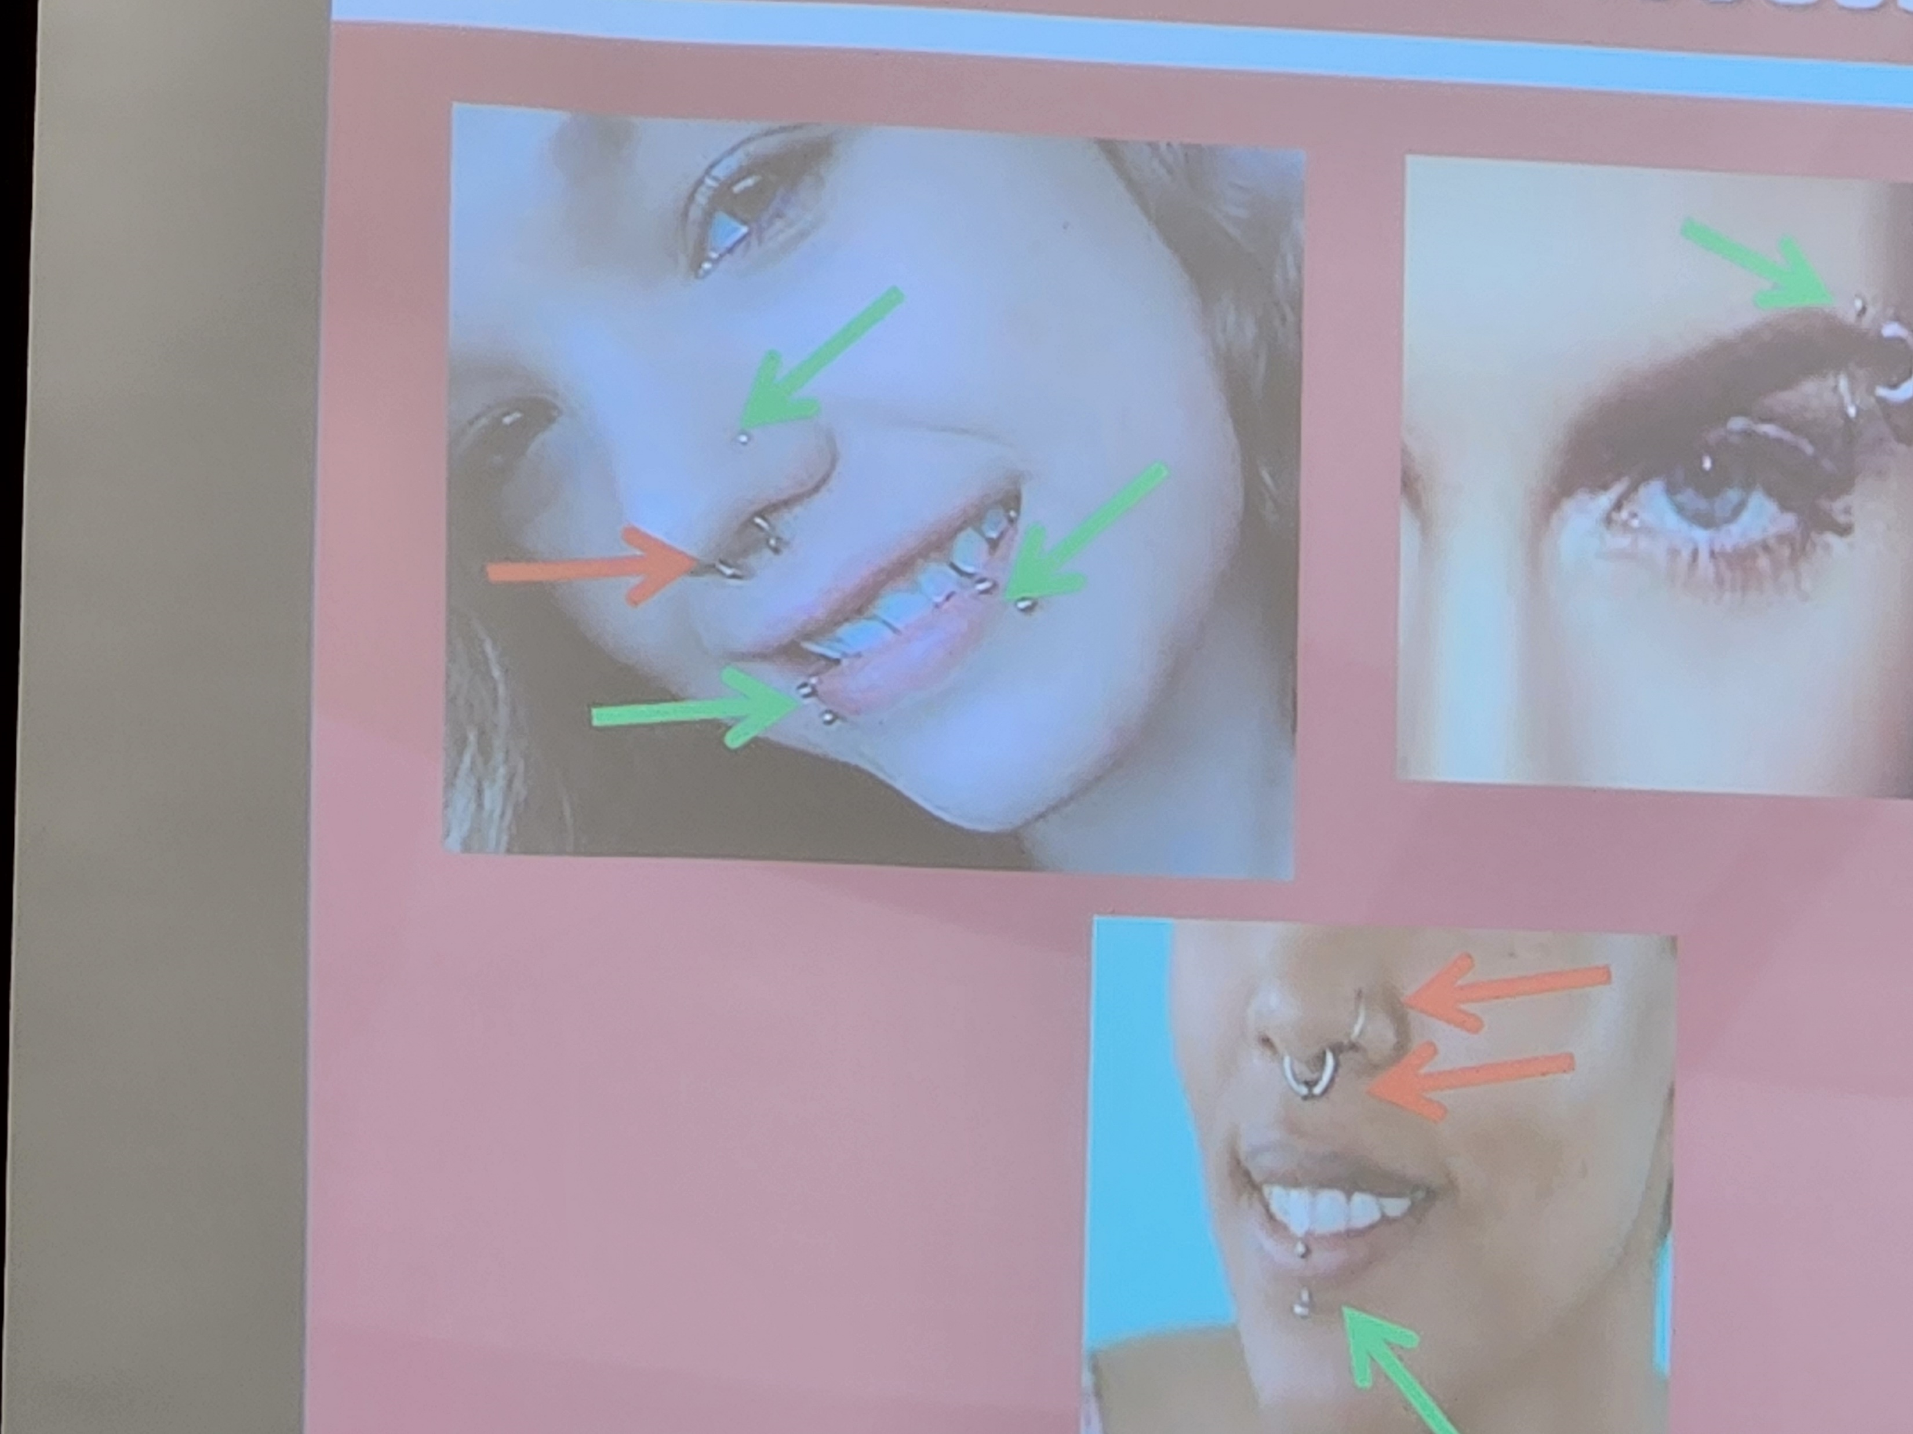

Slide 11
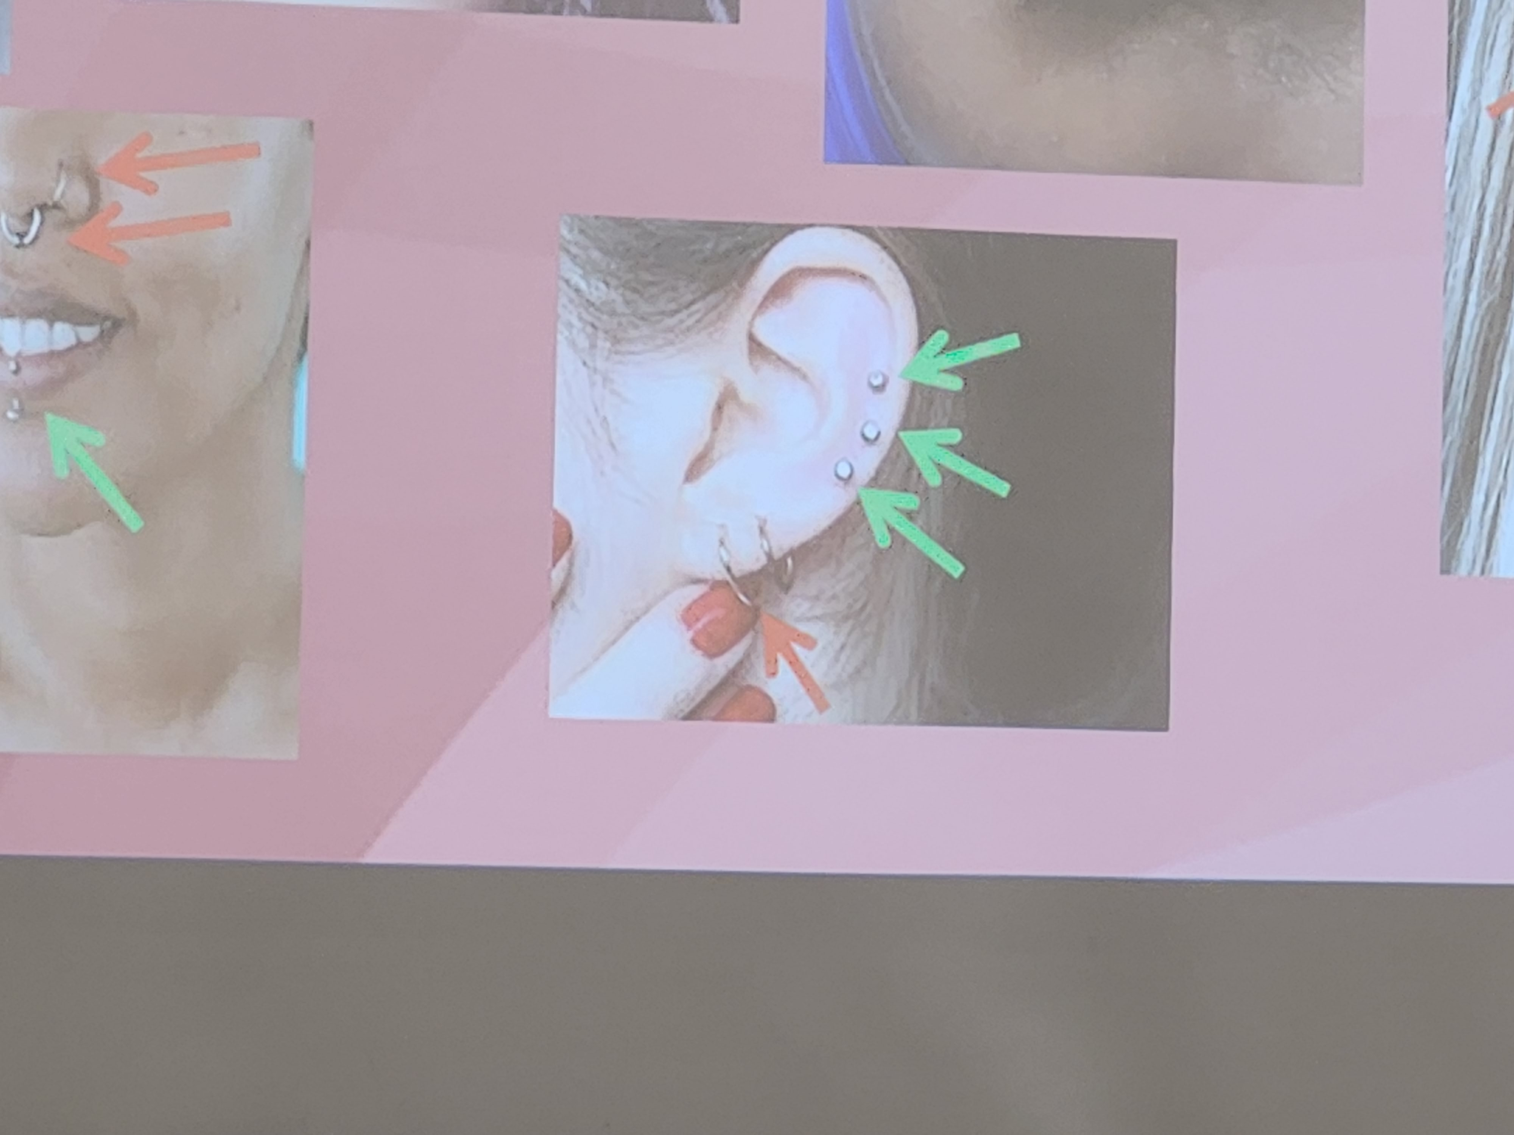

Slide 12
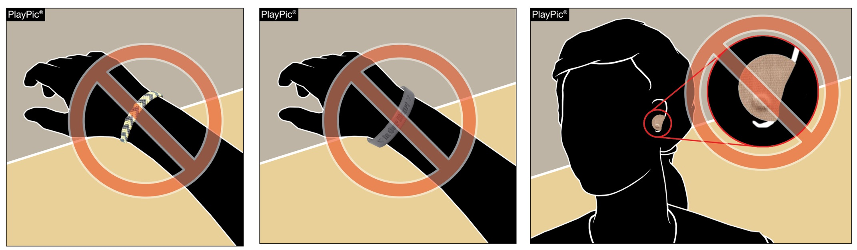
Equipment and accessories
4-1-7
String bracelets, commemorative bracelets and body jewelry are considered jewelry and are not permitted.
Taping over jewelry is not permitted.
  Exceptions remain for religious and medical alert medals
Notes:
String bracelets, commemorative bracelets and body jewelry are considered jewelry and are not permitted.
Taping over jewelry is not permitted.
Exceptions remain for religious and medical alert medals
Rationale: Allows limited use of jewelry above the chin keeping with current trends of other NFHS and volleyball rules codes.

Slide 13
Coach – Educate your players and take care of jewelry before the match...
PLEASE!!
It is your responsibility.

Slide 14
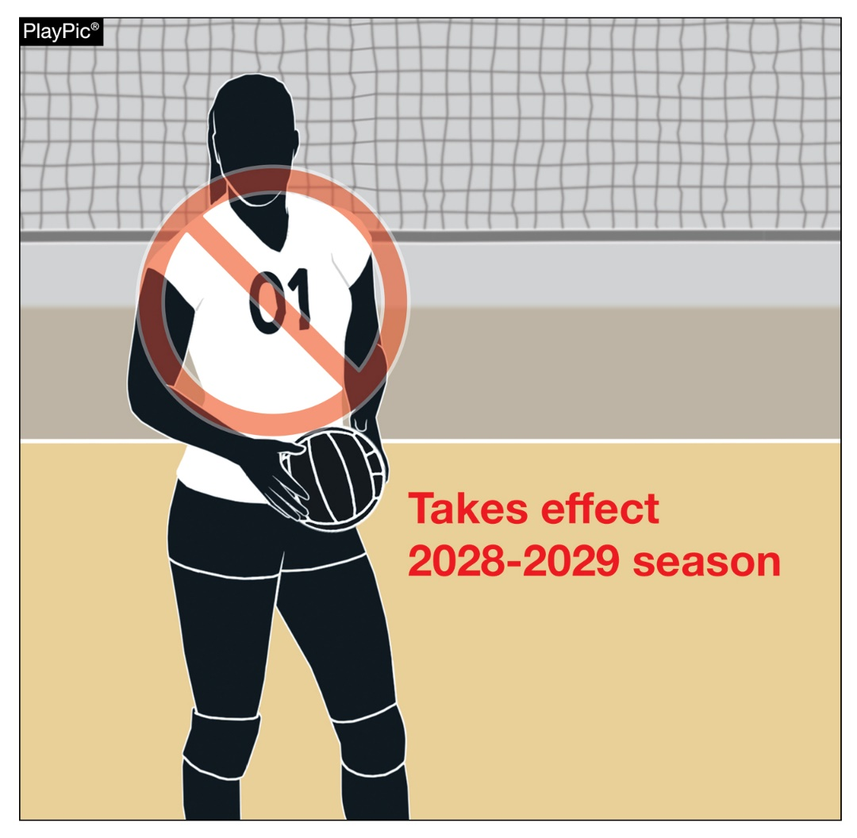
Legal uniform
4-2-4b
Numbers with a leading zero (01, 02, 03, etc.) will be non-compliant beginning in 2028.
Legal uniforms must be numbered 0-99.
Notes:
Numbers with a leading zero (01, 02, 03, etc.) will be non-compliant beginning in 2028.
Legal uniforms must be numbered 0-99.
Rationale: Clarifies legal numbers and eliminates confusion when signaling while aligning with other rules codes.

Slide 15
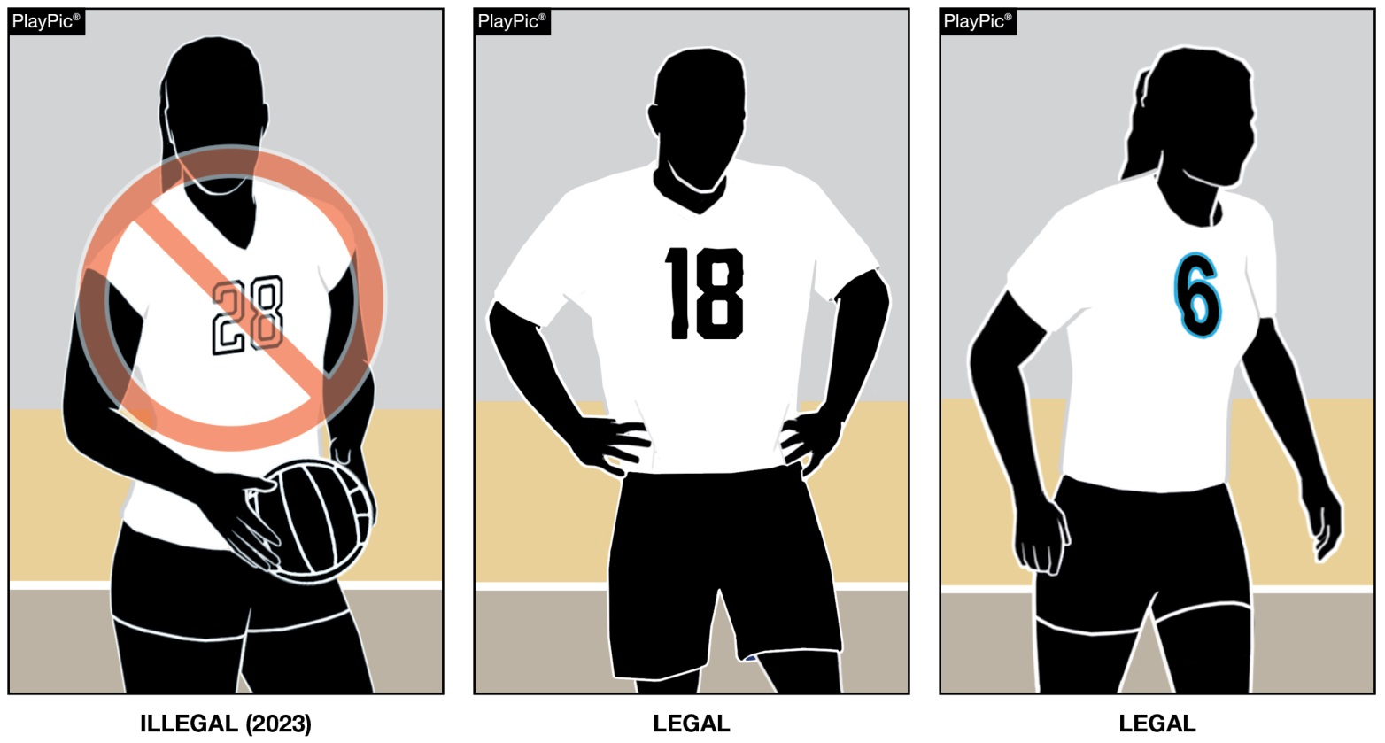
4-2-4c legal uniform
Beginning with the 2023 season (THIS SEASON), the body of the uniform number must clearly contrast with the uniform top regardless of the border/trim.
Notes:
Beginning with the 2023 season, the body of the uniform number must clearly contrast with the uniform top regardless of the border/trim.
Rationale: This change was approved in 2019 to allow officials and scorers to easily identify uniform numbers and align with other rules codes.

Slide 16
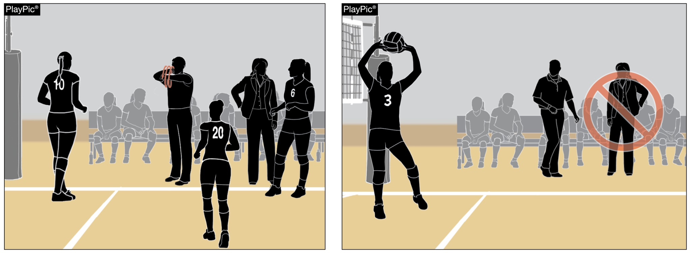
conduct
5-5-3b(11), 12-2-6
Dead Ball
Live Ball
One assistant coach may stand within the coaching zone to provide instruction during
dead-ball situations only.
The assistant coach who stands may change throughout the match – only one can stand
at a time.
Notes:
One assistant coach may stand within the coaching zone to provide instruction during dead-ball situations only.
The assistant coach who stands may change throughout the match – only one can stand at a time.
Rationale: Allows an assistant coach to stand and coach during dead-ball situations in addition to the head coach. This allows for assistant coaches to provide position- or situation-specific coaching.

Slide 17
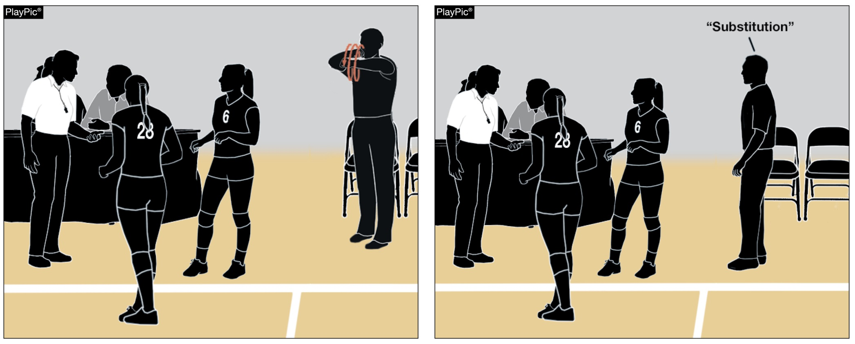
Procedure for substitution
10-2-1
The head coach may signal or verbally request a substitution.
Notes:
The head coach may signal or verbally request a substitution.
Rationale: Creates consistency by allowing either a verbal or non-verbal signal for as substitution.

Slide 18
2023-24 NFHS Volleyball
Points of Emphasis

Slide 19
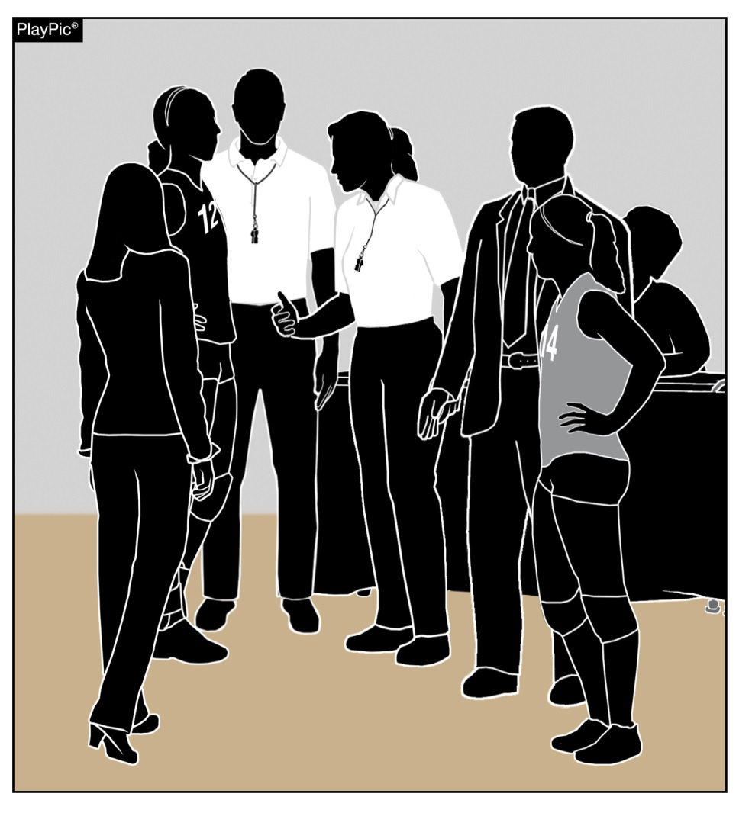
Coaching Zone privileges
The pre-match conference provides an opportunity for the officials to identify the head coach of each team for the current match.
During the pre-match conference, officials should remind head coaches that only one assistant coach at a time may stand during a dead ball.
The privilege to stand during play shall not be designated to an assistant coach – no transferring of the power to stand and coach during play.
Notes:
The pre-match conference provides an opportunity for the officials to identify the head coach of each team for the current match.
During the pre-match conference, officials should remind head coaches that only one assistant coach at a time may stand during a dead ball.

Slide 20
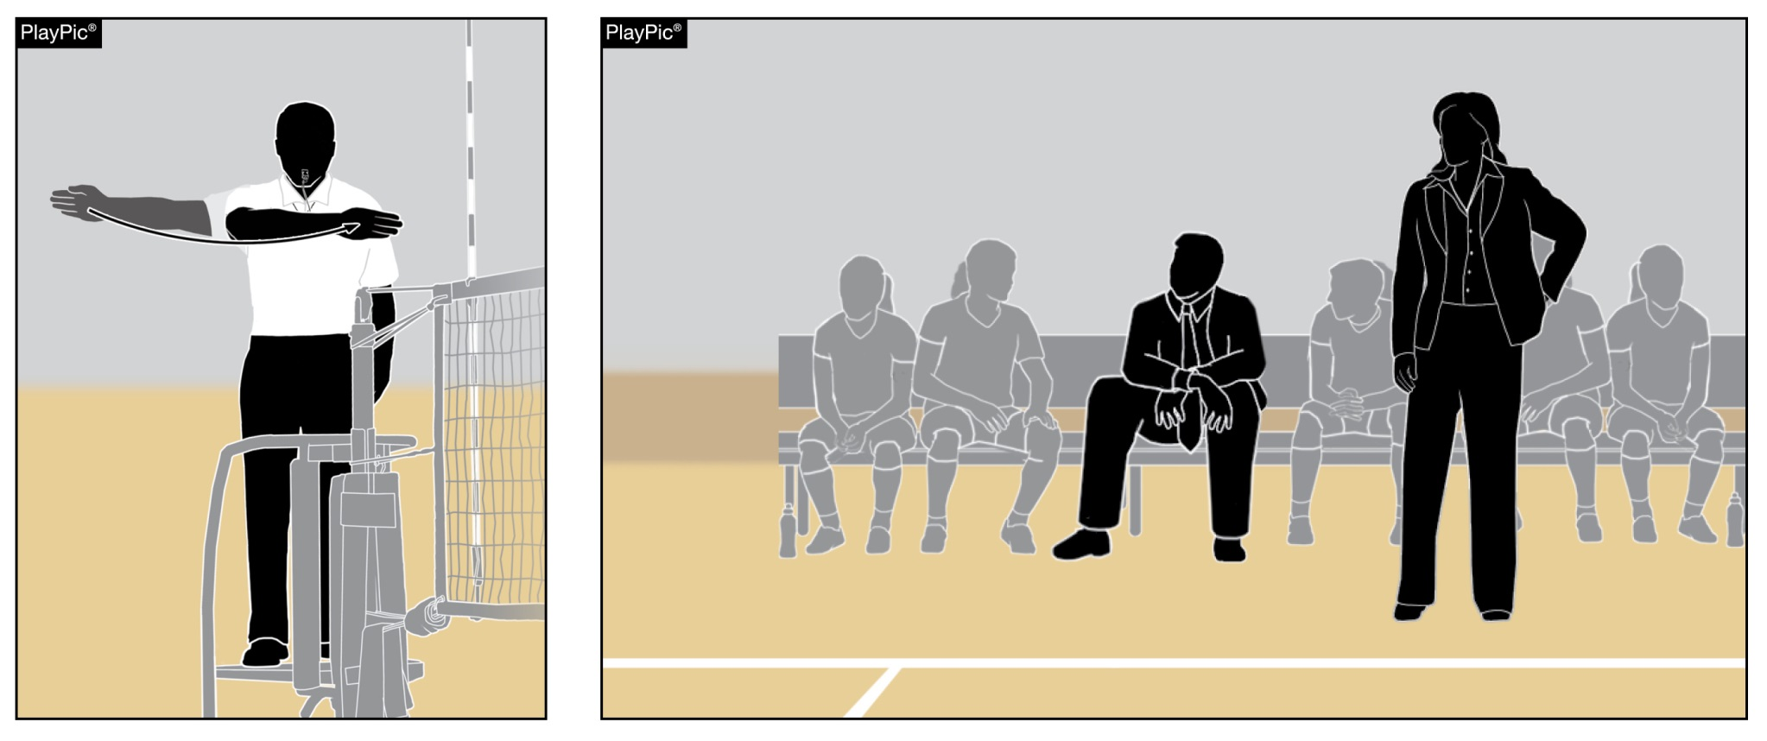
Coaching Zone privileges
Once the first referee extends an arm for the authorization of serve, the assistant coach must return to the bench and may not stand again until the next dead ball.
Notes:
Once the first referee extends an arm for the authorization of serve, the assistant coach must return to the bench and may not stand again until the next dead ball.

Slide 21
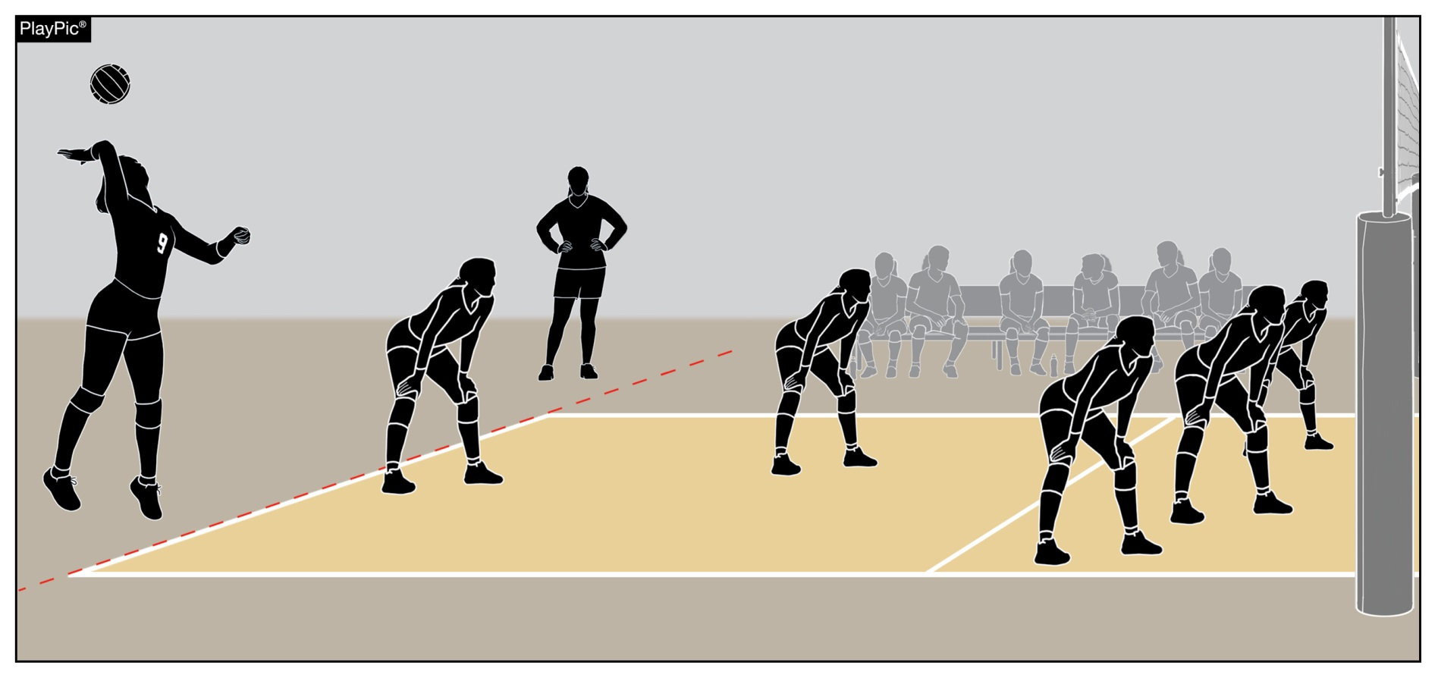
Coaching Zone privileges
The head coach may stand and coach beyond the libero replacement zone. However, the coach must remain six feet off the court during play and may not cross the sideline extended during dead-ball situations.
Notes:
The head coach may stand and coach beyond the libero replacement zone. However, the coach must remain six feet off the court during play and may not cross the sideline extended during dead-ball situations.

Slide 22
Coaching Zone privileges
Assistant coaches may not address officials, except during a dead ball to:
  Review the accuracy of the score,
  Verify the number of time-outs used by their team,
  Verify the number of substitutions used by their team,
  Request the serving order of their team, or
  Verify the proper server for the opponent.
Abuse of these privileges will result in:
  Yellow Conduct Card (warning) for first minor offense;
  Red Conduct Card (penalty) for first serious or second minor offense and loss of rally/point is awarded to opponent.
  All coaches (including head coach) must now remain seated for the remainder of the match.
Rules 12-2-6
Notes:
Assistant coaches may not address officials, except to:
Review the accuracy of the score,
Verify the number of time-outs used by their team,
Verify the number of substitutions used by their team, or
Verify the proper server for the opponent.
Abuse of these privileges will result in:
Yellow Conduct Card (warning) for first minor offense;
Red Conduct Card (penalty) for first serious or second minor offense and loss of rally/point is awarded to opponent.

Slide 23
RECAP: COACHING ZONE & WHO STANDS
Only the HEAD coach from each team may address the referees for the purpose of quickly clarifying a non-judgmental ruling.
Coaching Zone location: libero replacement zone extending beyond the end line and sideline extended - distance of at least 6 feet from sideline during live-ball situations & may approach sideline during dead-ball situations
Only ONE assistant coach may stand during a dead ball to instruct players. No standing during play (live ball.)
When the First Referee has extended the arm for service – need to be making your way back to the bench or be seated on the bench.

Slide 24
Playable/nonplayable areas
It is the responsibility of the host school to adhere to the requirements of both the court and all game equipment as outlined in Rules 2 and 3.
  The match shall not be played when padding requirements are not met and the state association shall be notified to determine further action or penalty, as deemed necessary.
  When game equipment, other than required padding, does not meet rule specifications, the match shall be conducted, and the improper conditions reported to the appropriate authority.
Officials evaluate each site before their assigned match and determine playable and nonplayable areas, keeping risk minimization and fairness in mind in the application of the rules.
Notes:
It is the responsibility of the host school to adhere to the requirements of both the court and all game equipment as outlined in Rules 2 and 3.
The match shall not be played when padding requirements are not met and the state association shall be notified to determine further action or penalty, as deemed necessary.
When game equipment, other than required padding, does not meet rule specifications, the match shall be conducted, and the improper conditions reported to the appropriate authority.
Officials evaluate each site before their assigned match and determine playable and nonplayable areas, keeping risk minimization and fairness in mind in the application of the rules.
State or regional assignors may create and provide a compilation of ground rules for each school prior to each season to help mitigate potential confusion.

Slide 25
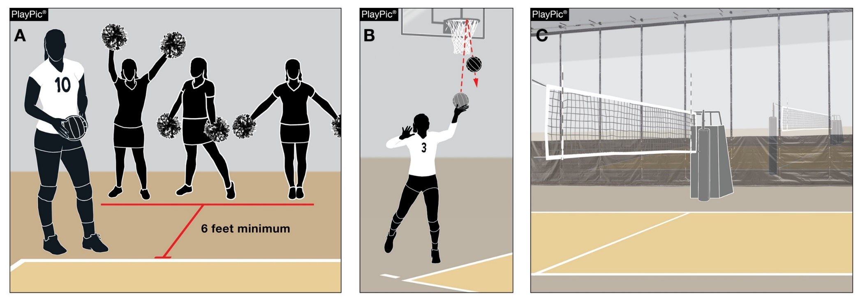
Playable/nonplayable areas
Officials may need to communicate ground rules during the pre-match conference addressing the following:
Extended space needed for serving when the minimum 6 feet (2 meters) is not available (PlayPic A);
Overhead obstructions (basketball goals, batting cages, wrestling and/or cheer mats, running tracks, ceiling fans, speakers, beams, air ducts, ropes, lighting, banners, flags, scoreboard, etc.) ( PlayPic B);
Divider nets (PlayPic C).
Notes:
Officials may need to communicate ground rules during the pre-match conference addressing the following:
Extended space needed for serving when the minimum 6 feet (2 meters) is not available (PlayPic A);
Overhead obstructions (basketball goals, batting cages, wrestling and/or cheer mats, running tracks, ceiling fans, speakers, beams, air ducts, ropes, lighting, banners, flags, scoreboard, etc.) ( PlayPic B);
Divider nets (PlayPic C).

Slide 26
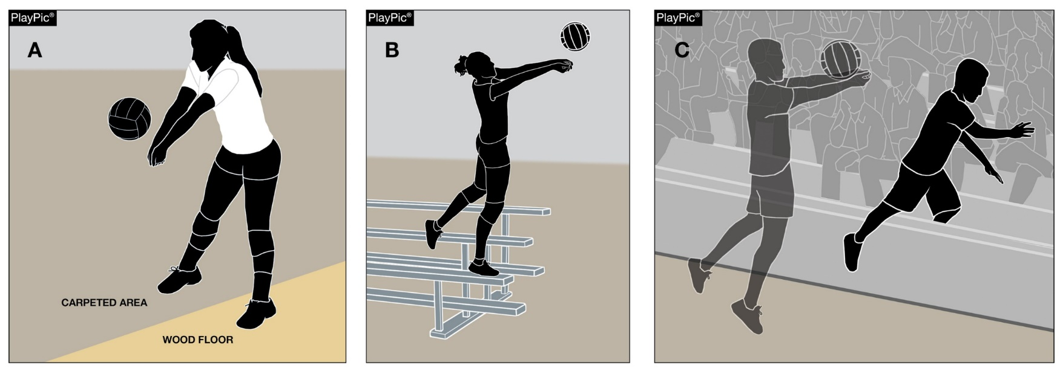
Playable/nonplayable areas
Rule 2-4-2 allows a player to retrieve a ball near a nonplayable area, if a body part is in contact with the playable area during the player’s contact of the ball – regardless of if a foot or another body part is in the nonplayable area. (PlayPic A)
  It is not the location of the ball, but the locale of the player.
  A player can reach into a nonplayable area.
  A player can also enter the nonplayable area after contact. (PlayPic C)
  Being in contact with anything to gain an advantage, like bleachers, is illegal. (Play Pic B)
Notes:
Rule 2-4-2 allows a player to retrieve a ball near a nonplayable area, if a body part is in contact with the playable area during the player’s contact of the ball – regardless of if a foot or another body part is in the nonplayable area. (PlayPic A)
It is not the location of the ball, but the locale of the player.
A player can reach into a nonplayable area.
A player can also enter the nonplayable area after contact. (PlayPic C)
Being in contact with anything to gain an advantage, like bleachers, is illegal. (Play Pic B)

Slide 27
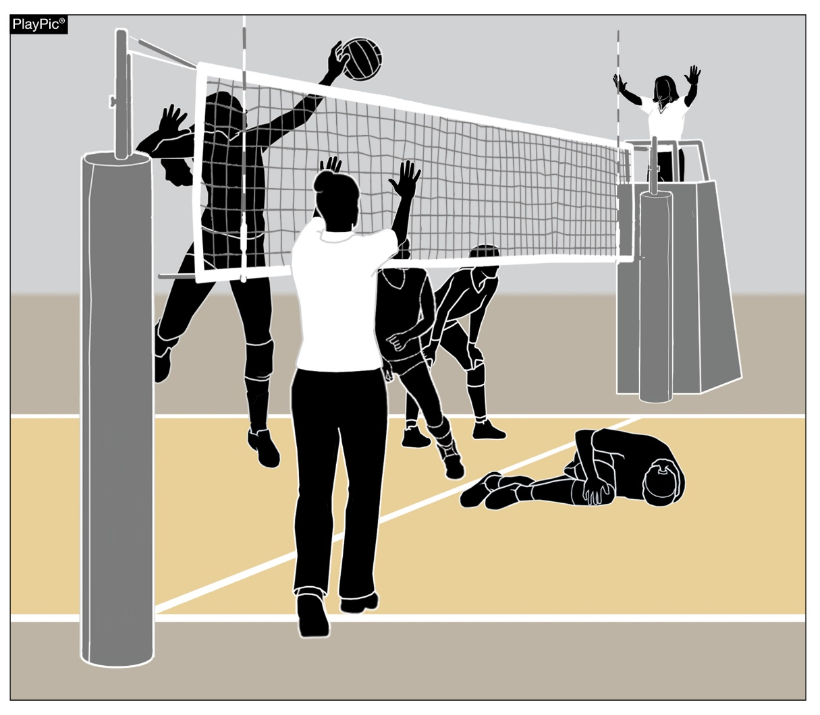
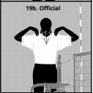
Injury procedure
If an injury occurs during play, either referee can suspend play by sounding a loud double whistle and holding up both hands.
Both officials should signal a referee’s time-out.
Notes:
Risk minimization is the officials’ primary responsibility.
If an injury occurs during play, either referee can suspend play by sounding a loud double whistle and holding up both hands.
Both officials should signal a referee’s time-out.

Slide 28
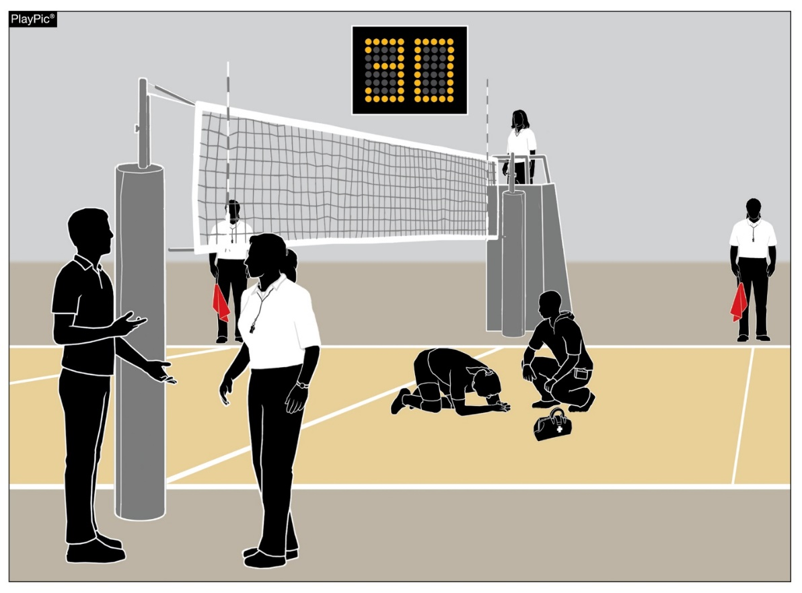
Injury procedure
Rule 11-4-1 allows the coach 30 seconds to decide:
  The player can continue to play,
  To substitute/replace the injured player, or
  Take a time-out (if the team still has one remaining).
Notes:
The first referee remains on the stand, while the second referee allows the injured players’ coach or medical staff to attend to the injured player.
Line Judges should take their time-out position near the first referee.
All officials should refrain from taking a position near the injured player.
Rule 11-4-1 allows the coach 30 seconds to decide:
The player can continue to play,
To substitute/replace the injured player, or
Take a time-out (if the team still has one remaining).
The second referee needs to communicate with one of the injured team’s coaches regarding their options and then explain that they have 30 seconds to choose an option before starting the watch.

Slide 29
Injury procedure
A player does not have to be moved within the 30-second period. Only team personnel or medical staff decides on the appropriateness of moving an injured player, regardless of how long it may take.
If the coach opts to substitute, the injured player does not follow normal substitution protocol.
Once the injured player is removed from the playing surface safely, the second referee follows the substitution protocol – signal/whistle – ensure that the substitute is recognized and recorded by the scorer.
If play was interrupted, the referees will administer a replay and continue play.
The injured player who is legally replaced, may return to the set.
Notes:
A player does not have to be moved within the 30-second period. Only team personnel or medical staff decides on the appropriateness of moving an injured player, regardless of how long it may take.
If the coach opts to substitute, the injured player does not follow normal substitution protocol.
Once the injured player is removed from the playing surface safely, the second referee follows the substitution protocol – signal/whistle – ensure that the substitute is recognized and recorded by the scorer.
If play was interrupted, the referees will administer a replay and continue play.
The injured player who is legally replaced, may return to the set.

Slide 30
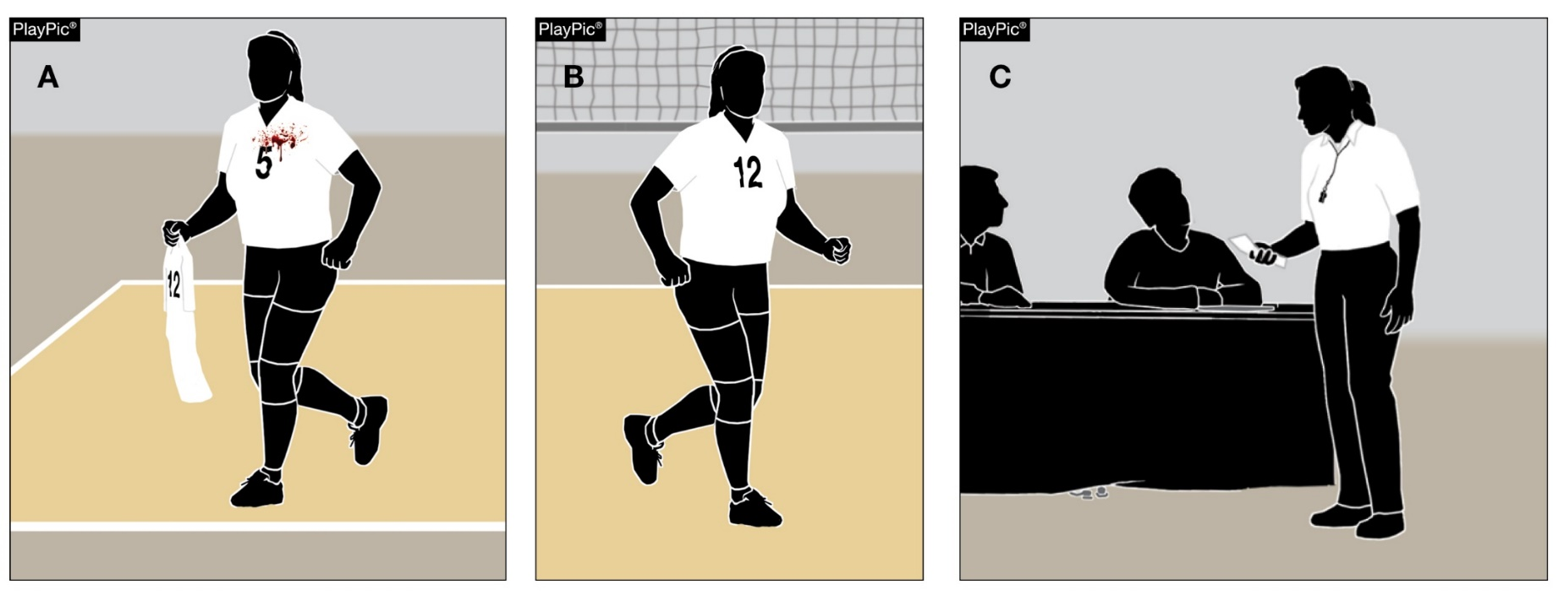
Injury procedure
Blood Situations:
Blood oon a player, uniform, equipment or playing surface, play shall be suspended.
Team personnel can aid a player.
If there is blood on a jersey or player equipment, it must be appropriately cleaned or removed.
The referees will allow a player to change jerseys – away from the court area.
The second referee should scan the court and check the game ball(s) to ensure there is no blood.
Medical staff can attend to the court and game ball(s) with the appropriate solution to remove any blood.
Notes:
As soon as an official recognizes blood on a player, uniform, equipment or playing surface, play shall be suspended.
Team personnel can aid a player.
If there is blood on a jersey or player equipment, it must be appropriately cleaned or removed.
The referees will allow a player to change jerseys – away from the court area.
The second referee should scan the court and check the game ball(s) to ensure there is no blood.
Medical staff can attend to the court and game ball(s) with the appropriate solution to remove any blood.

Slide 31
Injury procedure
Concussion Protocols:
Any athlete who exhibits signs, symptoms, or behaviors consistent with a concussion (such as loss of consciousness, headache, dizziness, confusion, or balance problems) shall be immediately removed from the contest and shall not return until cleared by an appropriate health-care professional.
Notes:
Concussion Protocols:
Any athlete who exhibits signs, symptoms, or behaviors consistent with a concussion (such as loss of consciousness, headache, dizziness, confusion, or balance problems) shall be immediately removed from the contest and shall not return until cleared by an appropriate health-care professional.
It is not the responsibility of an official to assess a potential concussion.
It is appropriate for an official to suggest to a coach to attend to a player exhibiting the above signs, refraining from assessing that you think the player has a concussion.

Slide 32
Injury procedure
Exceptional Substitution:
Team exhausts 18 substitutions or no legal substitutes are available, and an injury occurs - a replacement needed - team granted an exceptional substitute in priority order.
  Teammate who has never played in the set or a player who has played in that position.
  Any non-libero teammate on the bench who not currently being replaced by the libero.
  Libero if no other possible substitutes exist. (Must change jerseys.)
The injured player cannot re-enter that set if replaced by an exceptional substitute.
Notes:
Exceptional Substitution:
If a team has exhausted their allowable 18 substitutions or no legal substitutes are available, and an injury occurs where a replacement is needed, a team may be granted an exceptional substitute in priority order.
By a teammate who has never played in the set or a player who has played in that position.
By any non-libero teammate on the bench who is not currently being replaced by the libero.
By a libero if no other possible substitutes exist. (Must change jerseys.)
The substitute counts as a team substitution and the injured player cannot re-enter that set if replaced by an exceptional substitute.

Slide 33
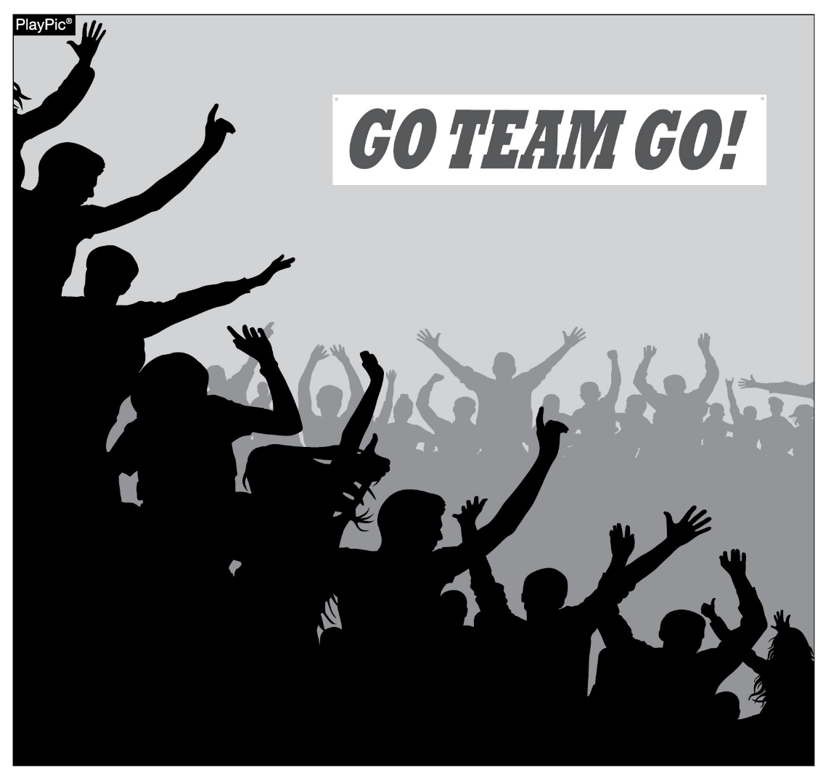
sportsmanship
Promote - respect, integrity and sportsmanship.
Everyone involved in these programs must be doing their part.
  Coaches, Players, School Administration and FANS!!
Notes:
NFHS playing rules are written to encourage sportsmanship. Participation in these programs should promote respect, integrity and sportsmanship. However, for these ideals to occur, everyone involved in these programs must be doing their part.
Sportsmanship, or good sporting behavior, is about treating one another with respect and exhibiting appropriate behavior. It is about being fair, honest and caring. When these types of appropriate behavior occur, competitive play is more enjoyable for everyone.

Slide 34
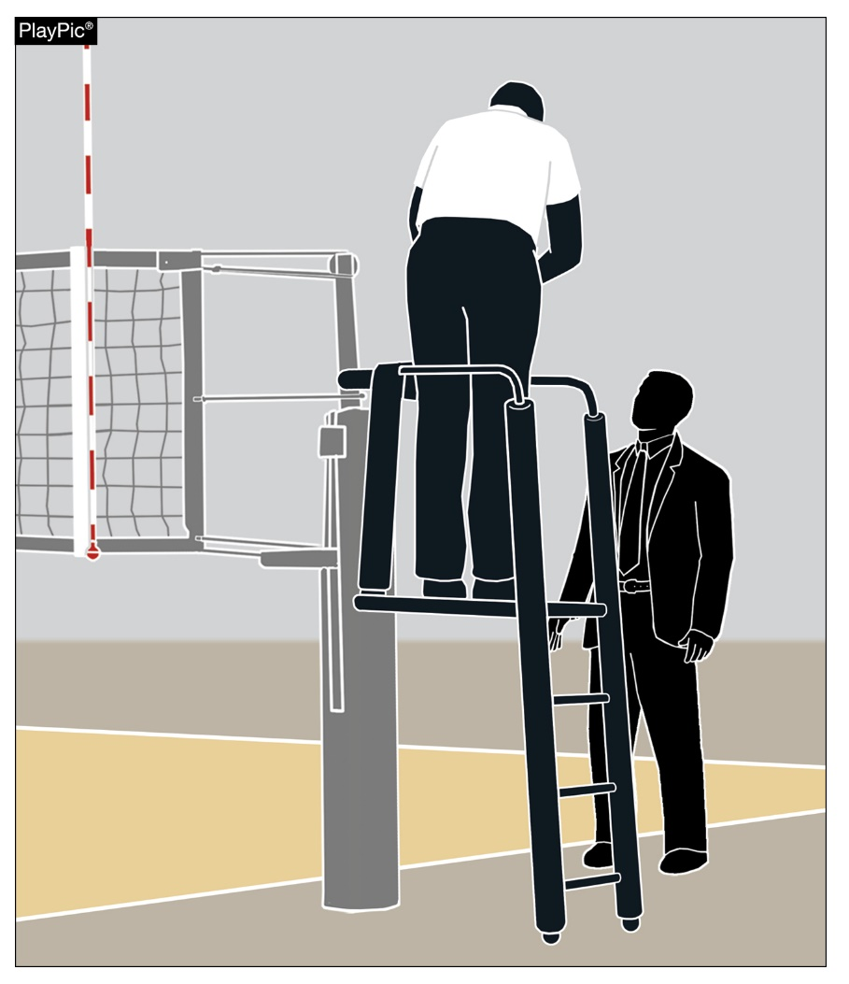
sportsmanship
There must be a collaborative, working relationship between contest officials and game administration to promote good sportsmanship and safely conduct the contest.
Student fan behavior... Let’s hear and see more cheering for their own team!!
Coach is the default HOST MANAGER should a match administrator not be on site!!
Notes:
There must be a collaborative, working relationship between contest officials and game administration to promote good sportsmanship and safely conduct the contest.
Everyone has their roles to play in creating a positive, sportsmanlike atmosphere at contests.

Slide 35
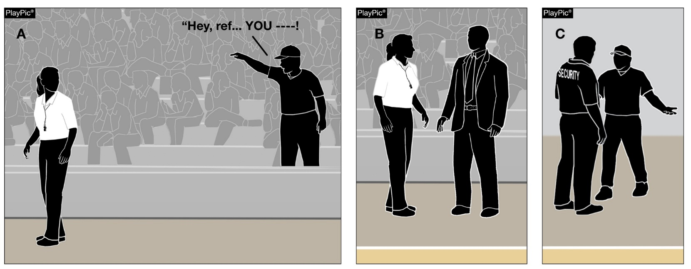
sportsmanship
Officials - never engage with spectators who are exhibiting “bad behavior”.
School administration - responsible for dealing with unruly spectators.
Spectators exhibiting “bad behavior” (demeaning/profane language/animal sounds) – those individuals MUST removed from the contest by school administration.
Notes:
Contest officials should never engage with spectators who are exhibiting unsporting behavior.
Once the contest begins, school administration is responsible for dealing with unruly spectators.
If spectators are using demeaning or profane language at officials – or at others in the stands – those individuals should be removed from the contest by school administration.

Slide 36
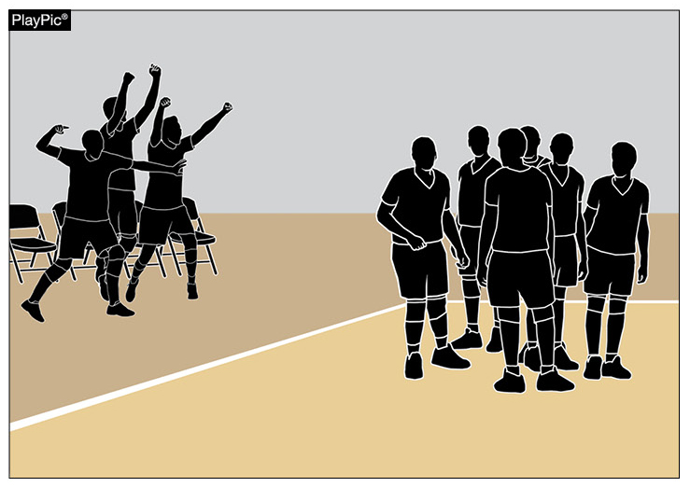
Bench Behavior/sportsmanship - reminder
Rule 12-2-7a allows bench personnel to, “Spontaneously react to an outstanding play by members of their own team.”
Team celebrations must be done in an appropriate, sporting manner.
The location and duration of these celebrations should not impede with the normal flow of the match.
“Beach Whale” look must stop!
Notes:
Rule 12-2-7a allows bench personnel to, “Spontaneously react to an outstanding play by members of their own team.”
Team celebrations must be done in an appropriate, sporting manner.
The location and duration of these celebrations should not impede with the normal flow of the match.

Slide 37
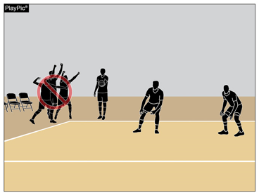
Bench Behavior/sportsmanship - reminder
Celebrations that continue after teams are ready for play and/or move outside of the bench area may be deemed excessive.
Excessive and disruptive reactions may result in unsporting conduct penalty.
Notes:
Celebrations that continue after teams are ready for play and/or move outside of the bench area may be deemed excessive.
Excessive and disruptive reactions may result in an unsporting conduct penalty as described in Rule 12-2 PENALTIES.

Slide 38
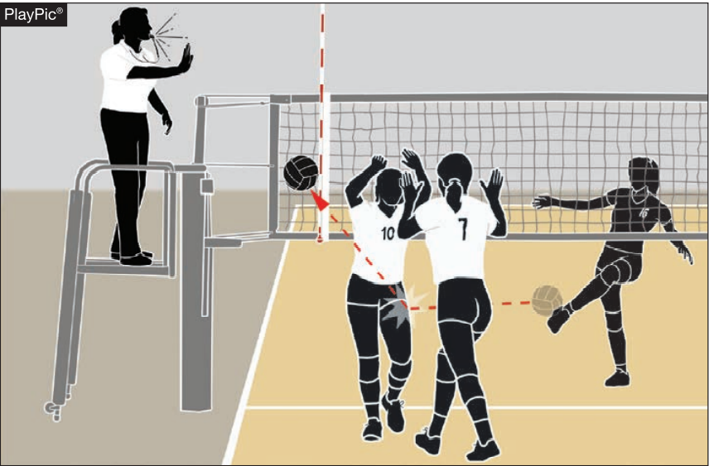
Behavior/sportsmanship - reminder
Playing a ball AFTER the referee has sounded the whistle to stop play can create a dangerous situation for other players and officials.
Depending on the severity of the infraction, the first referee can penalize a team/player with anything from an oral warning to a match disqualification.
Notes:
We’ve all heard the phrase, “Play until you hear the whistle.” In fact, many officials state that phrase during the captains meeting when discussing playable areas or overhead obstructions. But what about when players continue to play after the whistle? Players who continue to play once a referee has whistled to stop play may be participating in unsporting conduct and can and should be penalized by the first referee, if in the judgment of the official, the player’s conduct is unsporting.
One of the reasons this rule is put in place is to prevent potential injuries to players and officials. When a player continues to make a play on the ball when others have stopped, there is a chance a ball can strike someone and cause serious injury. This type of misconduct can be subtle or done in a very aggressive manner.
In situations where a player(s) continues to play a ball that has been whistled dead, the first referee has options at his or her disposal to address the situation. The first option would be to beckon the offending team’s captain to the referee stand and give a verbal warning that play must stop when the whistle is blown or there could be a penalty given to the offending team.
The first referee can also issue a yellow conduct card as a formal warning to a team. The first referee may give the yellow conduct card to an individual player or the entire team. If a team has been yellow-carded previously in the match for unsporting behavior, the next incident during the match, regardless of the type of misconduct, should result at a minimum in a red card and penalty point against the offending team.
The first referee must consider the severity of the infraction before making a judgment on how to adjudicate it. Not all situations are the same. Some are unconscious negligence on the part of a player. Sometimes you can be in a noisy environment and a player may not hear the whistle to stop play.
However, there are other times when players consciously play the ball when they are not supposed to. These acts must be addressed immediately! A situation you may see involves players, frustrated by a ball they mishit into the net that rebounds back to them, firing the ball under the net to the opposing side. This is dangerous as there could be a blocker in the air returning to the court who unknowingly comes down on the ball. Often the opponents are celebrating and not paying attention to a ball coming from the other side at a high rate of speed. You will also see players forcefully kicking the ball underneath the net, as shown in the PlayPic. This is even more dangerous as the ball, when kicked, can rise and strike someone in the face or other sensitive areas.
Then you can have the most egregious circumstance, when a player hears the whistle but intentionally spikes the ball over the net at an opponent with intent to injure. These extreme situations should be met with a match disqualification. Remember, there is no progression on the penalty scale in these situations. Egregious and blatant misconduct can be met with severe penalties for a team or player.

Slide 39
NIAA Ejection Procedures for Players & Coaches
(PER SPORTSMANSHIP COMMITTEE RECOMMENDATIONS)
(Effective August 2019)
PLAYERS
When a PLAYER is ejected, player remains on bench. If she causes further problems, she will be asked to leave but must be supervised.
With the ejection, PLAYER is suspended for the next scheduled contest. PLAYER must complete NFHSLearn “Sportsmanship” Course before she becomes eligible to participate in any future contest.
By NIAA rules, player is allowed to be on the bench at the next scheduled contest, not in uniform and not allowed to participate in warmups or to be introduced with the team.

Slide 40
NIAA Ejection Procedures for Players & Coaches
(PER SPORTSMANSHIP COMMITTEE RECOMMENDATIONS) Effective August 2019
COACHES (Defined in NAC 385B.822)
COACH ejected, must leave “premises” …in a timely manner.
COACH suspended for next scheduled contest.
COACH must complete NFHSLearn “Teaching and Modeling Behavior” Course before becoming eligible to coach in any future contest.
By NIAA rules, coach not allowed to be on “premises” at next scheduled contest. NOT allowed to show up at the next scheduled match for warm-ups etc. - and then leave when the match begins.
Coach, ejected from contest, NOT allowed to make their way back onto court when match has concluded; if they do then they are subjected to being ejected again if behavior is unsportsmanlike.
Notes:
COACHES
When a COACH is ejected, the coach must leave the “premises”. (Defined in NAC 385B.822)
With the ejection, the COACH is suspended for the next scheduled contest.
COACH must complete NFHSLearn “Teaching and Modeling Behavior” Course before he/she becomes eligible to coach in any future contest.
By NIAA rules, he/she is not allowed to be on the “premises” at the next scheduled contest.
NO LONGER will coaches be allowed to show up at the next scheduled game/match for warm-ups etc. - and then leave when the game/match begins.
NO LONGER are coaches, who have been ejected from a contest, allowed to make their way back onto the field / court when the game has concluded. If they do, they are subject to being ejected again if their behavior is unsportsmanlike.
Sometimes coaches are ejected, and they refuse to leave the “premises” in a timely manner. Officials are to note this on their ejection report and depending on the circumstances, the coach may be subject to further sanctioning depending on the severity of the situation as reported by the official(s). In many cases, the official will not start the game until the coach is “out of site” / “out of sound” – If the coach refuses to leave – the official has the authority to forfeit the contest.

Slide 41
NIAA Ejection Procedures for Players & Coaches & Spectators
(PER SPORTSMANSHIP COMMITTEE RECOMMENDATIONS)
(Effective August 2024)
PLAYERS, COACHES, and SPECTATORS
With the ejection, PLAYER or COACH is suspended for the next TWO scheduled contest. PLAYER must complete NFHSLearn “Sportsmanship” Course before she becomes eligible to participate in any future contest.
Spectators.....Administration needs to remove those fans. Next year there will be a policy/regulation in place to not only eject a fan but to suspend them from contests including a lifetime ban.

Slide 42
Sportsmanship &
Officials Appreciation Week
Spectators: Students, Parents, and Fans
  Bench Bad Behavior
  Home management responsible for handling issue (s)
    Must have a “admin” on site or the coach handles
    Not the officials responsibility
  Student section “Positive” chants – stay in bleachers
NFHS/NIAA Officials Appreciation Weeks – All Sports – All levels
  Fall Sports - October 9th - October 14th, 2023 - pick a home date
  Athletic Director will receive information in late Aug/early Sept
  Elicit leadership students/student council/booster club/other
  Find ways for your coaches, participants, and fans to give special recognition and appreciation to the officials

Slide 43
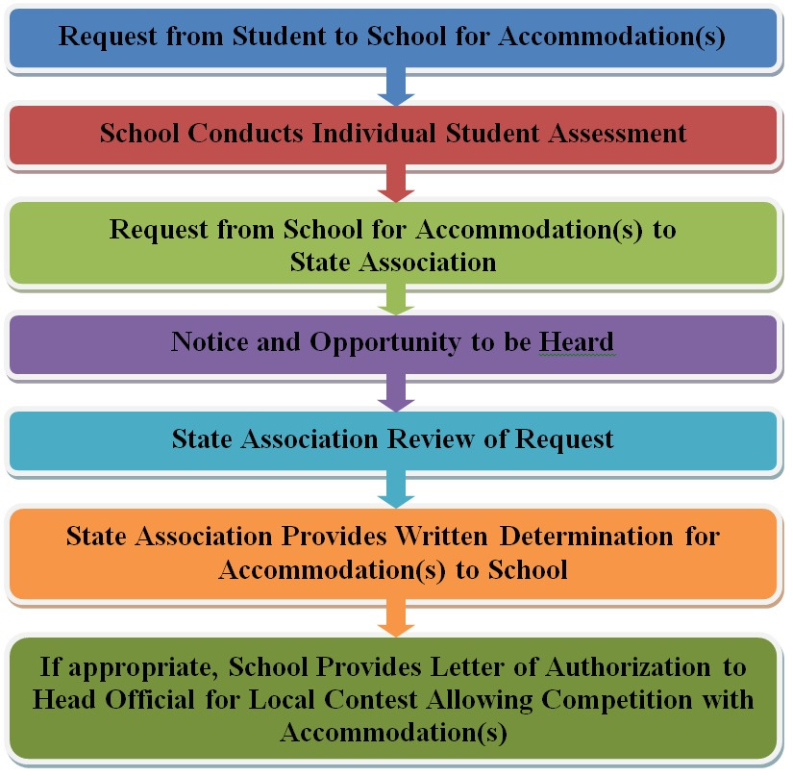
Guidelines for Schools and state associations for consideration of accommodations
Examples: Migraine earring not a post/stud, Insulin pump, head covering, etc.
Any special accommodation for an individual player
Any other special circumstances not covered by the rules
Secure authorization prior to season competition
Provide appropriate support material
Notes:
To assist state associations in working with schools for the inclusion of students with disabilities the following guide prepared by the NFHS Task Force on the Inclusion of Students with Disabilities is being provided for your review.
Following these guidelines will assist in the individual student assessment by the student and the school.
When requesting a possible accommodation, coaches should work with their school and the state association as early as possible in the sport season.
Contest officials shall defer decisions on rule accommodations to the respective state association.
This information serves as a guide. Each state association may develop its own process.

Slide 44
Niaa Reminders – member schools
Deletions
  Member schools may delete a maximum of 2 officials
  Deletion applies to all levels of the specific sport & season.
  Expires at end of season
Process
  Deletion MUST be submitted in writing by the principal to the Executive Director of the NIAA
  A specific explanation must accompany the request.
  All deletions must be submitted 7 days prior to the first scheduled contest (tournament or league/non-league match)
  Doesn’t apply to post-season competition.
  BE PROFESSIONAL in your explanation!
Notes:
Member Schools may delete a maximum of two officials in any one sport. A deletion shall apply to all levels of the specific sport and season for which it is submitted and shall expire at the end of that season. All deletions must be submitted in writing by the principal to the Executive Director of the Nevada Interscholastic Activities Association. A specific explanation must accompany the request. All deletions must be submitted 7 days prior to the first scheduled contest. This rule does not apply to post-season competition.

Slide 45
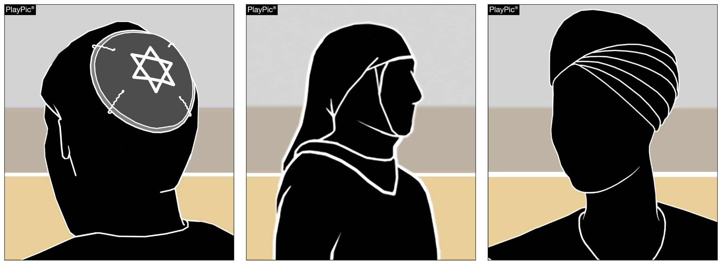
Rule 4-1-6a, b (Reminder)
Legal hair devices such as bobby pins and flat clips, may be used to secure head coverings. (4-1-6)
Players may wear head coverings for religious reasons.
The headwear must fit securely and be made of non-abrasive or soft materials.
Head coverings worn for medical reasons must still receive state association approval.
Notes:
Players may wear head coverings for religious reasons.
The headwear must fit securely and be made of non-abrasive or soft materials.
Legal hair devices such as bobby pins and flat clips, no longer than two inches, may be used to secure head coverings. (4-1-6)
Other fasteners that do not adhere to Rule 4-1-6 (those that are not flat or are longer than 2 inches) will be prohibited for the purposes of risk minimization.
Head coverings worn for medical reasons must still receive state association approval.
Rationale: This change eliminates the need for authorization from the state association for the wearing of religious headwear without data to support that this type of head wear creates an increased risk to the athlete or teammates, while maintaining the requirement for approval of head coverings worn for medical reasons – allowing the state association to review for the purposes of risk minimization.

Slide 46
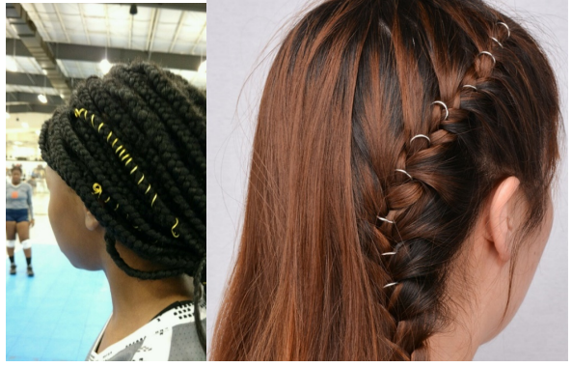
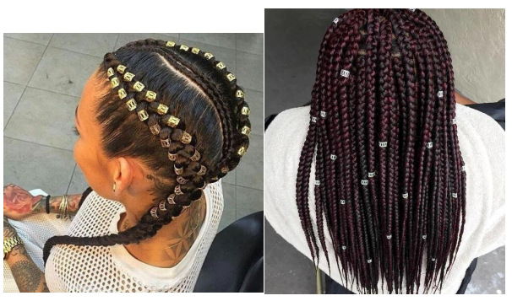
Equipment and accessories
4-1-6a
Hair control devices that are securely fastened and do not increase risk to the athlete, teammates and opponents are permitted.
Hair clips that are hard, protrude from the head and/or are easily dislodged do not comply and are not legal.
Notes:
Hair control devices that are securely fastened and do not increase risk to the athlete, teammates and opponents are permitted.
Hair clips that are hard, protrude from the head and/or are easily dislodged do not comply and are not legal.
Rationale: Eliminates the size restrictions of hair control devices while maintaining that the risk of injury to the athlete, teammates and opponents should not be compromised.

Slide 47
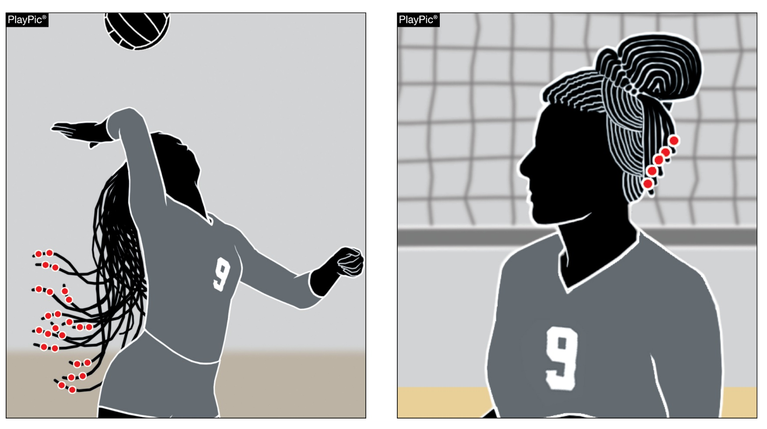
Equipment and accessories
4-1-6a
Hair adornments that are not securely fastened or do increase the risk to the player, teammates or opponents should be addressed by the official with the coach.
The player shall have the opportunity to make legal or remove.
Non-compliant
Compliant
Notes:
Hair adornments that are not securely fastened or do increase the risk to the player, teammates or opponents should be addressed by the official with the coach.
The player shall have the opportunity to make legal or remove.
Rationale: Creates inclusivity of hair styles while maintaining that the risk of injury to the athlete, teammates and opponents should not be compromised.

Slide 48
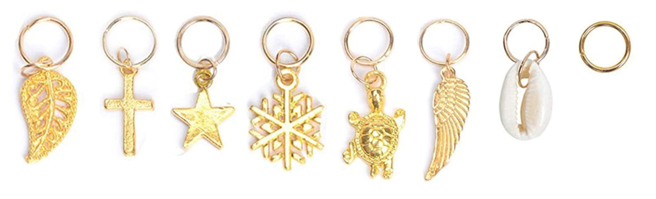
Equipment and accessories
4-1-6a
Hair charms are considered jewelry and per rule 4-1-7 would not be permitted.
Notes:
Hair charms are considered jewelry and per rule 4-1-7 would not be permitted.
Rationale: Maintains consistency that charms worn in the hair are considered jewelry and are not allowed.

Slide 49
4-2-2 Contrasting libero Uniform Requirements
ART 2…The libero uniform top must clearly contrast from the predominant color(s) of the team uniform top, excluding trim. The libero‘s uniform top cannot be made up solely of the same predominant color(s) of the team’s uniform top, even if the like color(s) are placed differently on the uniform top. Numbers shall meet all specifications in Rule 4-2-4.
The libero must clearly contrast with the rest of his/her teammates and conform to all other uniform rules.
Many of you have provided images of uniforms planning on purchasing!!

Slide 50
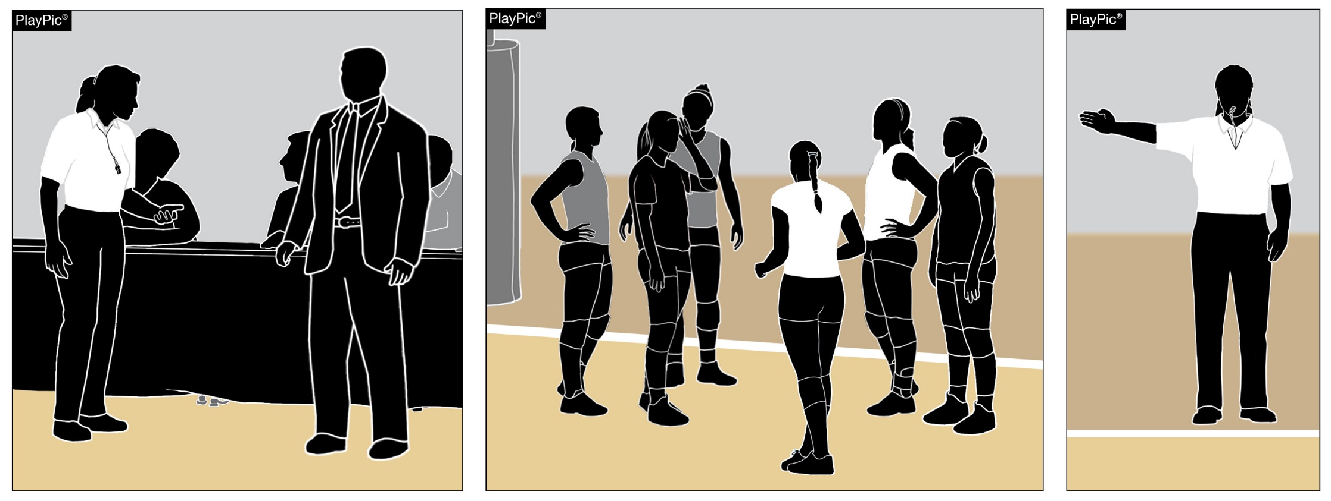
CHECK YOUR UNIFORMS for compliance – concerns
Process of Notification: The official shall first notify the coach about the illegal uniform(s). If the coach cannot fix the problem for the match and therefore does not have six players wearing legal uniforms, a loss of rally/point shall be awarded to the opponent at the beginning of the match and the state association shall be notified.
Notes:
Process of Notification: The official shall first notify the coach about the illegal uniform(s). If the coach cannot fix the problem for the match and therefore does not have six players wearing legal uniforms, a loss of rally/point shall be awarded to the opponent at the beginning of the match and the state association shall be notified.
The goal is to allow teams to compete provided there are no safety concerns and allow the state office to work with the school to correct the issue(s).

Slide 51
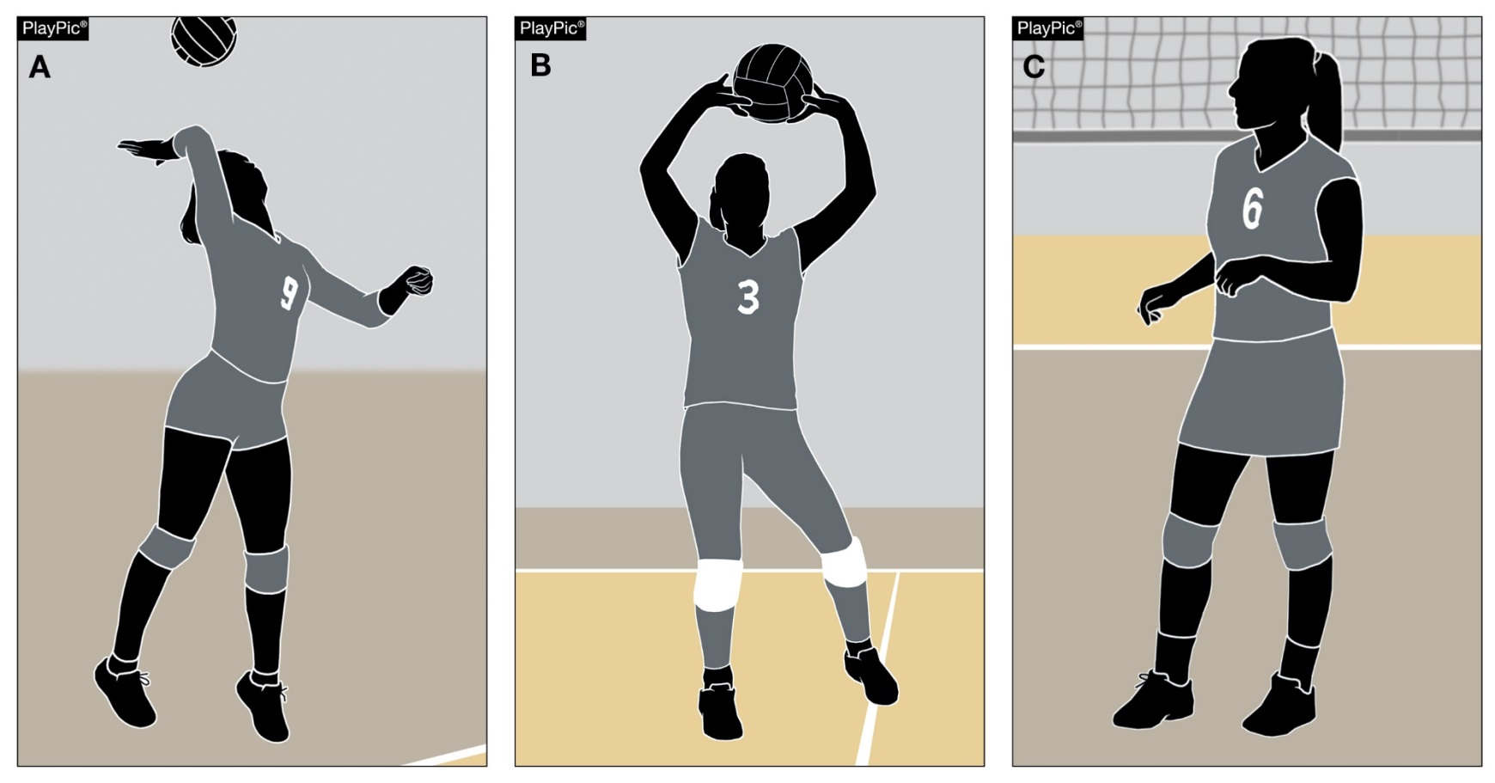
Addressing uniform concerns
Style of Uniform Bottoms:
  Multiple styles of uniform bottoms [shorts, spandex, pants (leggings) or skirts] are allowed by rule.
  A combination of like-colored bottoms may be worn within a team.
Notes:
Style of Uniform Bottoms:
Multiple styles of uniform bottoms [shorts, spandex, pants (leggings) or skirts] are allowed by rule.
A combination of like-colored bottoms may be worn within a team.

Slide 52
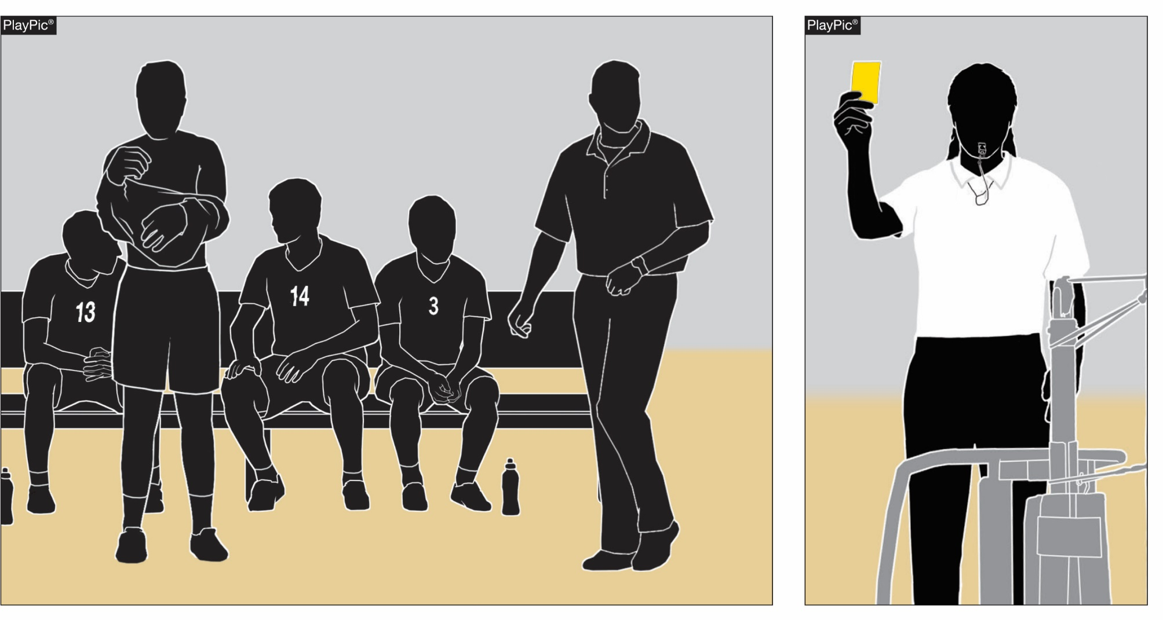
Legal UNIFORM: 4-2-7 Reminder
The penalty for the removal of any part of the uniform top or bottom is a yellow card charged to the coach for unsporting conduct.
Notes:
Rationale: Clarifies the penalty for the removal of any part of the uniform top or bottom as a yellow card (red card for subsequent offense) charged to the coach for unsporting conduct.
Go to the locker room or restroom to change uniform tops.

Slide 53
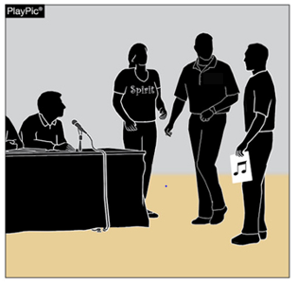
Management of non-team personnel - Reminder
Rules Reminder
It is the responsibility of coaches to educate school administration and the school community as to the sportsmanship nuances of the game of volleyball. This should include:
  Appropriate times cheerleaders may or may not cheer and proper location to cheer,
  Appropriate comments, timing of announcements and good sportsmanship by PA announcers;
  Appropriate time for music and sound effects (1-8);
  Appropriate location and behavior of fans and mascots, etc.
  NOISE MAKERS ARE NOT PERMITTED AT ANY TIME!!
Notes:
It is the responsibility of coaches to educate school administration and the school community as to the sportsmanship nuances of the game of volleyball. This should include:
Appropriate times cheerleaders may or may not cheer and proper location to cheer,
Appropriate comments, timing of announcements and good sportsmanship by PA announcers;
Appropriate time for music and sound effects (1-8);
Appropriate location and behavior of fans and mascots, etc.
NOISE MAKERS ARE NOT PERMITTED AT ANY TIME!!

Slide 54
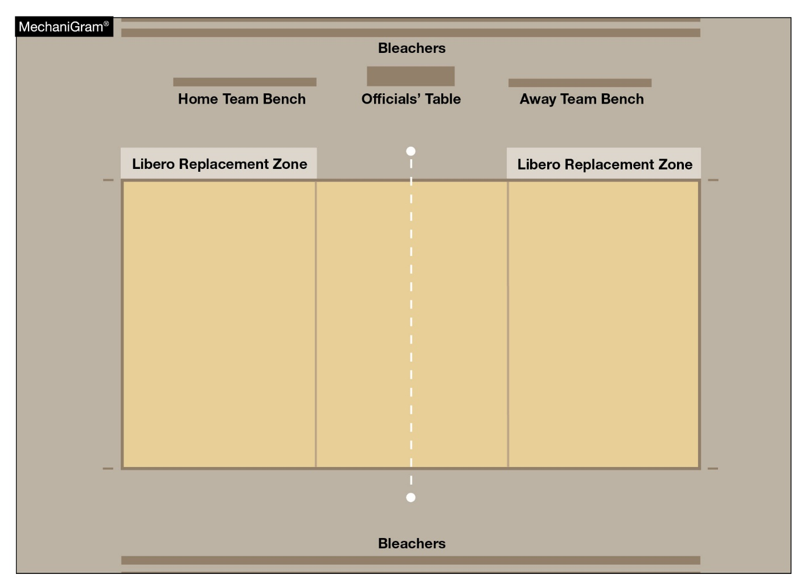
Team benches & TEAMS – NO SWITCHING
Teams and benches will remain on the same side of the court throughout the match.
NO SWITCHING SIDES
EXCEPTION: R1 & R2 determine a team has a distinct advantage/disadvantage
Hear the appeal from the coach prior to the start of the match and decide.
Notes:
The NFHS Volleyball Rules Book includes specific rule modifications that are allowed by state level adoption. Rules include:
Match format;
Forfeit protocol;
Uniform and equipment accommodations;
Line judge flags;
Electronic devices; and
Bench rotation.
State Associations may in compliance with the rules allow teams to remain on one designated side of the court occupying the same team bench throughout the match.
The NIAA will be surveying all schools regarding bench rotation or allowing teams to remain on one designated side of the court occupying the same team bench throughout the match. This survey will go to all coaches through the Athletic Administrator/Athletic Director…

Slide 55
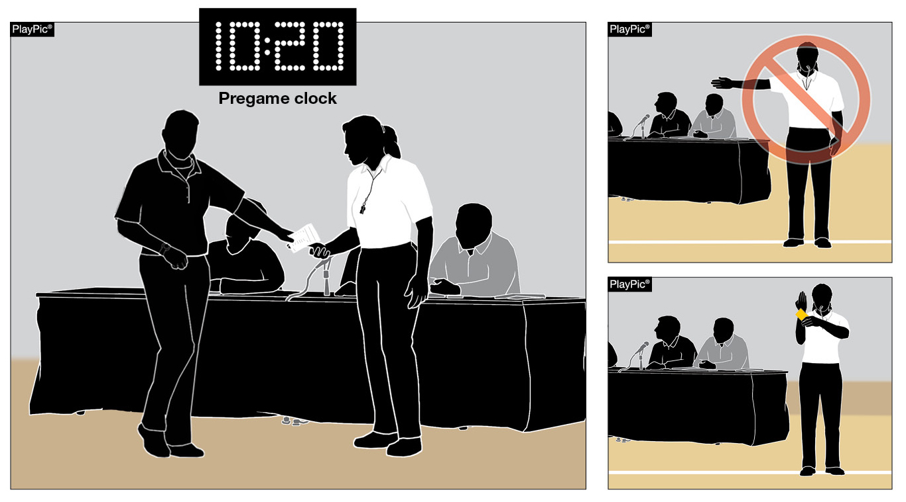
Roster submissions - reminder
7-1-1; 7-1-1 Penalties; 7-1-1 Penalties 2;9-9-1a ;10-3-7b
When a team roster is not ready for submission during the prematch conference, but is provided before 10 minutes remain on the clock…
The penalty is no longer a loss of rally/point.
It is now an unnecessary delay (administrative yellow card) assessed at the start of the set.
Notes:
When a team roster is not ready for submission during the prematch conference, but is provided before 10 minutes remain on the clock…
The penalty is no longer a loss of rally/point.
It is now an unnecessary delay (administrative yellow card) assessed at the start of the set.
Rationale: Creates an appropriate penalty progression for a late roster. Any corrections made to the roster after 10 minutes remain on the pregame clock still results in a loss of rally/point awarded to the opponent when the inaccuracy is discovered.
Note: Old 10-3-7b was deleted

Slide 56
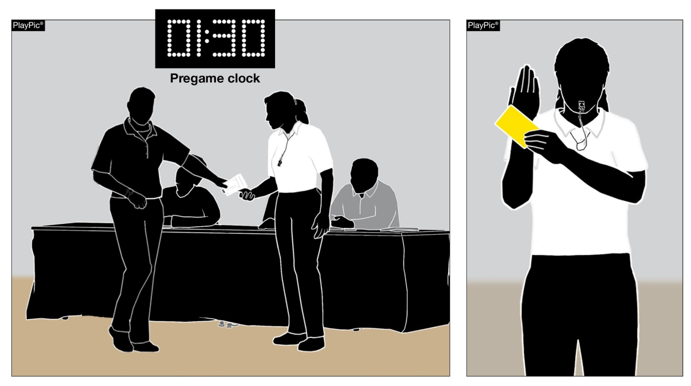
Lineup (prematch) - Rules 7-1-4 penalties(1), 9-9-1b
When a head coach submits a lineup after two minutes remain on the prematch clock, an unnecessary delay (administrative yellow card) is assessed at the start of set No. 1.
Notes:
Lineups are due to the second referee no later than two minutes prior to the end of the timed prematch warmup (7-1-2a).
When a head coach submits a lineup after two minutes remain on the prematch clock, an unnecessary delay (administrative yellow card) is assessed at the start of set No. 1.
Rationale: This change aligns the penalty for late lineup with that of a late roster. In addition, it lessons the severity of a late lineup by eliminating the automatic loss of rally/point penalty previously assessed.

Slide 57
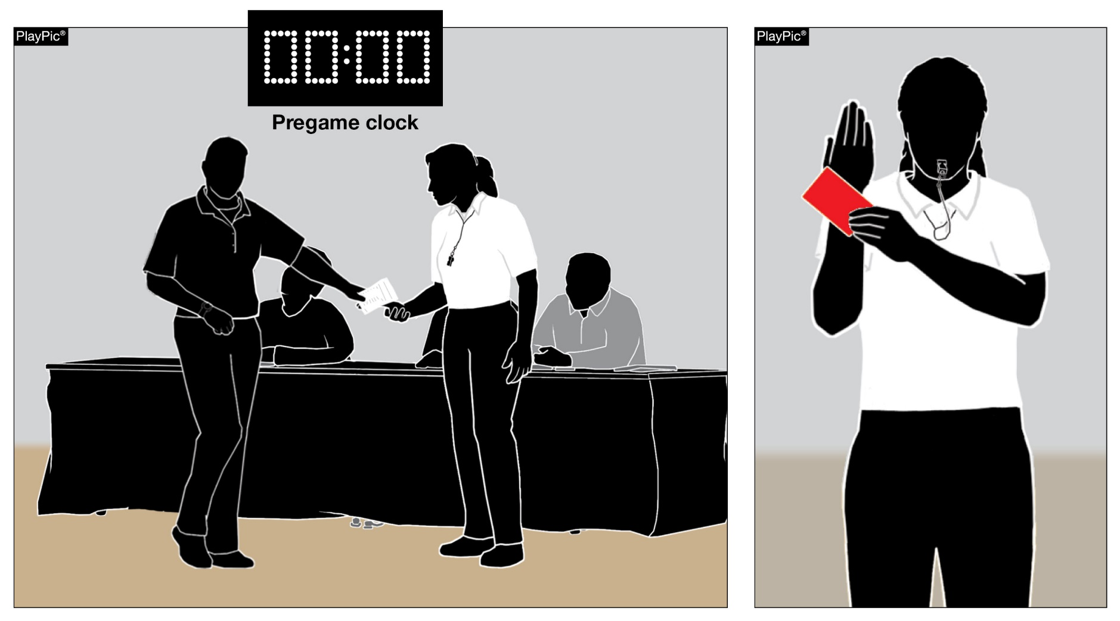
Lineup (prematch) - Rules 7-1-4 penalties(1), 9-9-1b
If the head coach has not submitted the lineup by the end of the prematch warmup, then subsequent unnecessary delay (administrative red card) assessed at the start of set No.1, which results in a loss of rally/point awarded to the opponent.
Notes:
If the head coach has not submitted the lineup by the end of the prematch warmup, a subsequent unnecessary delay (administrative red card) is assessed at the start of set No.1, which results in a loss of rally/point awarded to the opponent.
Rationale: This change allows for an appropriate penalty escalation.

Slide 58
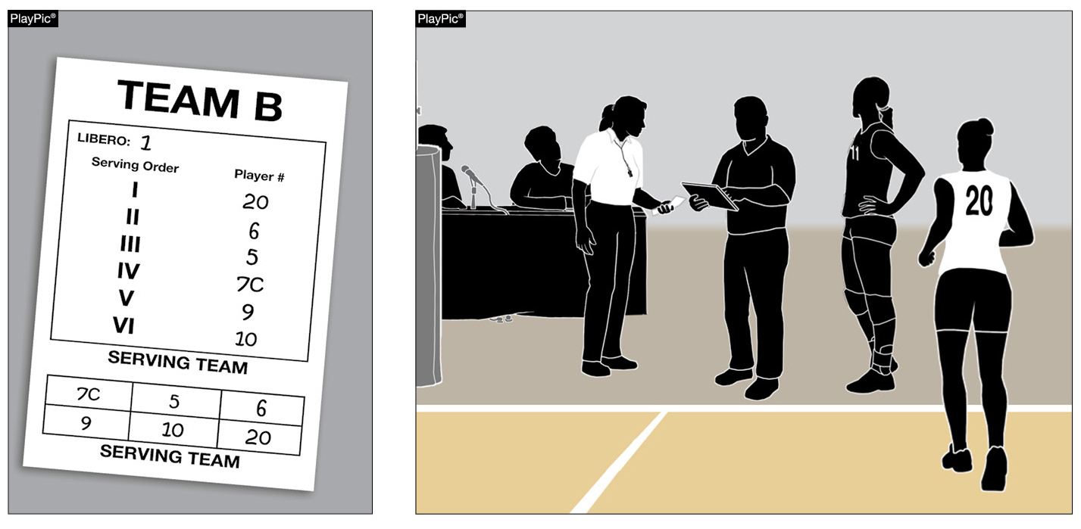
Correcting a submitted lineup - reminder
7-1-4a(1) & 7-1-4a(2) New
If a clerical error is made on the lineup by listing a libero number that no team member is wearing, the error shall be corrected without penalty.
Notes:
If a clerical error is made on the lineup by listing a libero number that no team member is wearing, the error shall be corrected without penalty.
Rationale: Creates consistency in allowing the correction of a clerical error (listing a number that no team member is wearing) on the lineup for a starting position and the libero position.

Slide 59
Prepping for season
Table Crew
  Adult at the table
  Train your scorer – experienced, should be adult
  Libero Tracker can be a player
  Timer/Clock person
  Score Book – train them; no switching during the match!!
Line Judges
  Frosh/JV matches Host school supplies
  Varsity matches – Host school supplies or NNVOA provides
  Train them – bring all LJs to the pre-match meet with R2 for instruction
Equipment
  Ref stand – safe and stable/ Poles - Padding
  Net and antenna
  Balls – NFHS authenticating mark (purchase game balls)
Uniforms – Legal?
Bench set up – chairs, other?
Ball Retrievers – MUST PROVIDE for all matches (exception at small schools)
Court Markings compliant??
ADD MATCHES TO SCHEDULE
  18 matches plus 2 tournaments

Slide 60
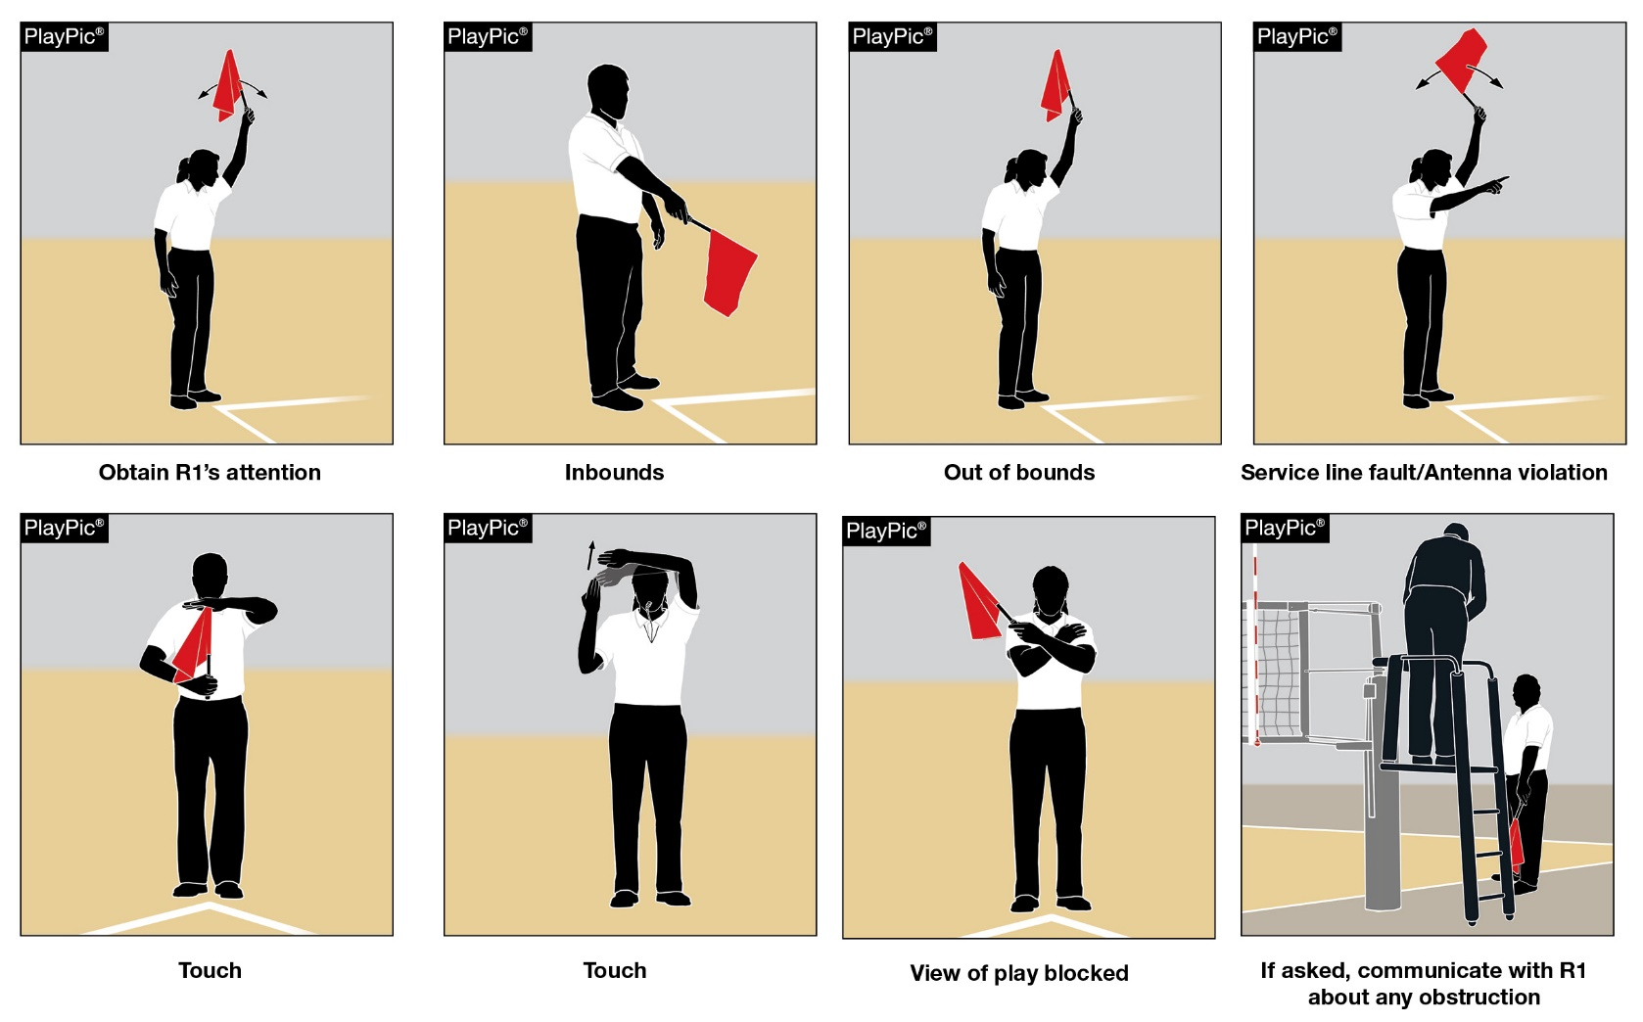
Line judge - training
TRAIN YOUR PLAYERS if not provided by your local association….
Server cannot contact the end line while contacting the ball for serve;
Define their two lines of responsibility (end line and sideline) on their court and the other court;
Remind them that a ball that lands on the line is “in”;
Remind them that “out” also includes a ball contacting either antenna or if the entire ball goes outside either of the antenna (the antenna extends above the ceiling to infinity);
Briefly explain the touch signal and that it is only needed at the end of a play;
Demonstrate each signal as you review.
Notes:
Line judges provided by schools….Those NOT provided by your local association…..TRAIN them and PLEASE supply flags.
Explain that a server cannot contact the end line while contacting the ball for serve;
Define their two lines of responsibility (end line and sideline) on their court and the other court; [sideline extends into the other court]
Remind them that a ball that lands on the line is in;
Remind them that out also includes a ball contacting either antenna or if the entire ball goes outside either of the antenna (the antenna extends above the ceiling to infinity) so if the ball would have touched the antenna or gone outside the antenna if it extended to the ceiling then the ball would be “out”;
Briefly explain the touch signal and that it is only needed at the end of a play;
Demonstrate each signal as you review.
Have each LJ demonstrate the signal and make corrections as needed.

Slide 61

Court markings - attack line - RULE 2-1-5 reminder
The attack line shall be solid and of one clearly visible color regardless of whether or not there is a logo on the court. This ensures visibility to determine legal player action. Put tape down so court is in compliance.
Attack line
Notes:
The attack line shall be solid and of one clearly visible color regardless of whether or not there is a logo on the court. This ensures visibility to determine legal player action.

Slide 62
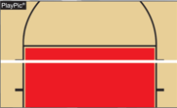


Courts and Markings Rule 2-1-2 reminder
The boundary lines of the court are strongly recommended to be one clearly visible color contrasting to the color of the floor.
A shadow-bordered line may be used for only the center line.
Boundary
Lines
Center line
Notes:
The boundary lines of the court are strongly recommended to be one clearly visible color contrasting to the color of the floor. A shadow-bordered line may be used for only the center line.
Center lines are required – they are NOT optional. Please make sure your courts have center lines- even for tournaments.

Slide 63
NFhS Volleyball Rules questionnaire & Rule Change Proposals
Comes out late November/December
Respond so you (coach) have a voice in rule proposals
Communicate your desires with your Athletic Administration
Submitting a Rule Change Proposal
  Go through me
  Go through NIAA
  We will review and if the NIAA approves…then it will be submitted.

Slide 64
Scrimmages
Aug. 9 @ Spanish Springs HS 6:30-7:30 (1 court)
Aug. 15 @ Spanish Springs HS 5:30-7:00 (2 courts)
Aug. 16 @ Carson HS vs Dayton 3:30-6:00/7:00 (1 or 2 courts)
Aug. 16 @ Douglas Co. Community & Senior Center 4:00-6:30 (4 courts Var/JV/Fr - Douglas, Mammoth, Yerington, Smith Valley, So. Tahoe)
OTHERS? Need more scrimmage dates.

Slide 65
Tournaments
Aug 18-19 Yerington (5 courts) - Fri 8AM & Sat 8AM
Aug 19 Truckee (JV/Frosh) (4 courts) - 8AM
Aug 26 Hug (Varsity) (3 courts) - 9AM
Aug 26 Dayton (JV/Frosh) (3 courts) - 8:00AM - NEW
Sep 1-2 High Sierra (Var) (6-9 courts) @ Swift Sports Dome
Fri 1PM & Sat 8AM
Oct 14 Manogue (JV/Frosh) (3 courts) 8am start
Oct 30-Nov 4 Regionals
Nov 9-11 State (South 5A, 2A - North 3A, 1A)
OTHERS????

Slide 66
QUESTIONS??
Good Luck Everyone
Stay safe
Have a great season!
See you on the court on!

